Slide 1
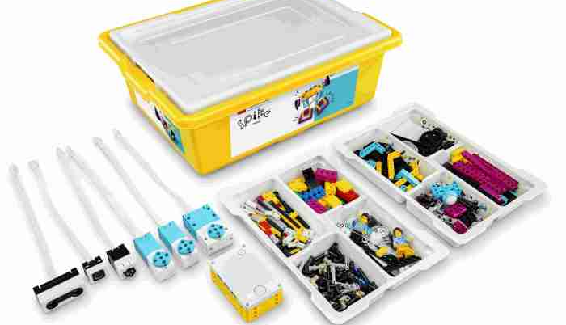
SPIKE PRIME vs ROBOT INVENTOR
SANJAY & ARVIND SESHAN

Slide 2
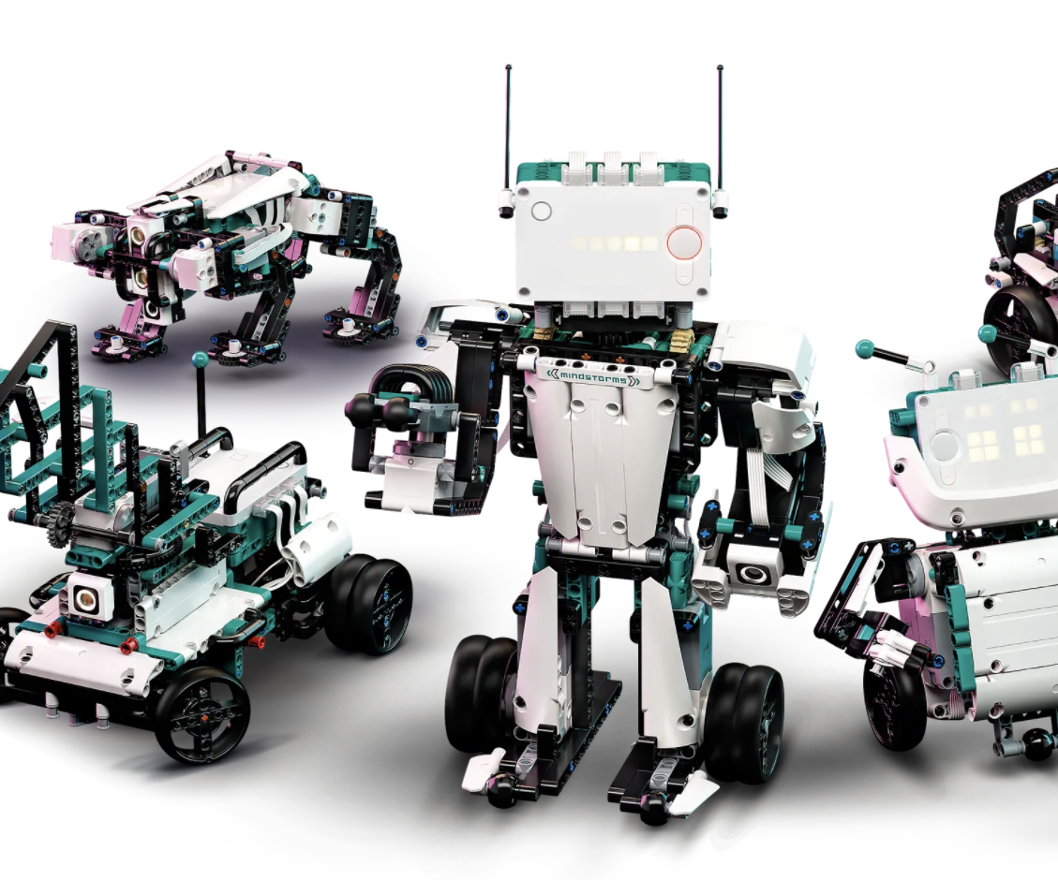
OVERVIEW
Five built-in models with instructions
Custom blocks for those models
Free programming area

Slide 3
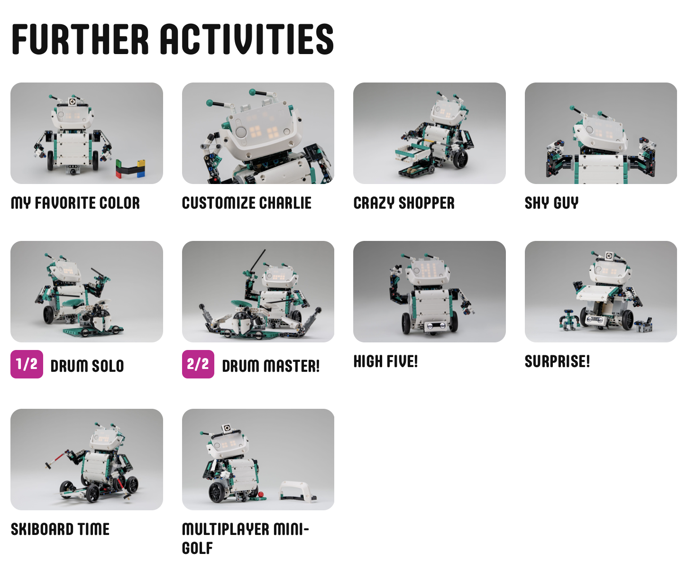
51515 IS PROJECT-BASED
Software walks you through building 5 large main models
“Further Activities” expand on all the models
Activities incorporate sensors
Focus is on home learning and play

Slide 4
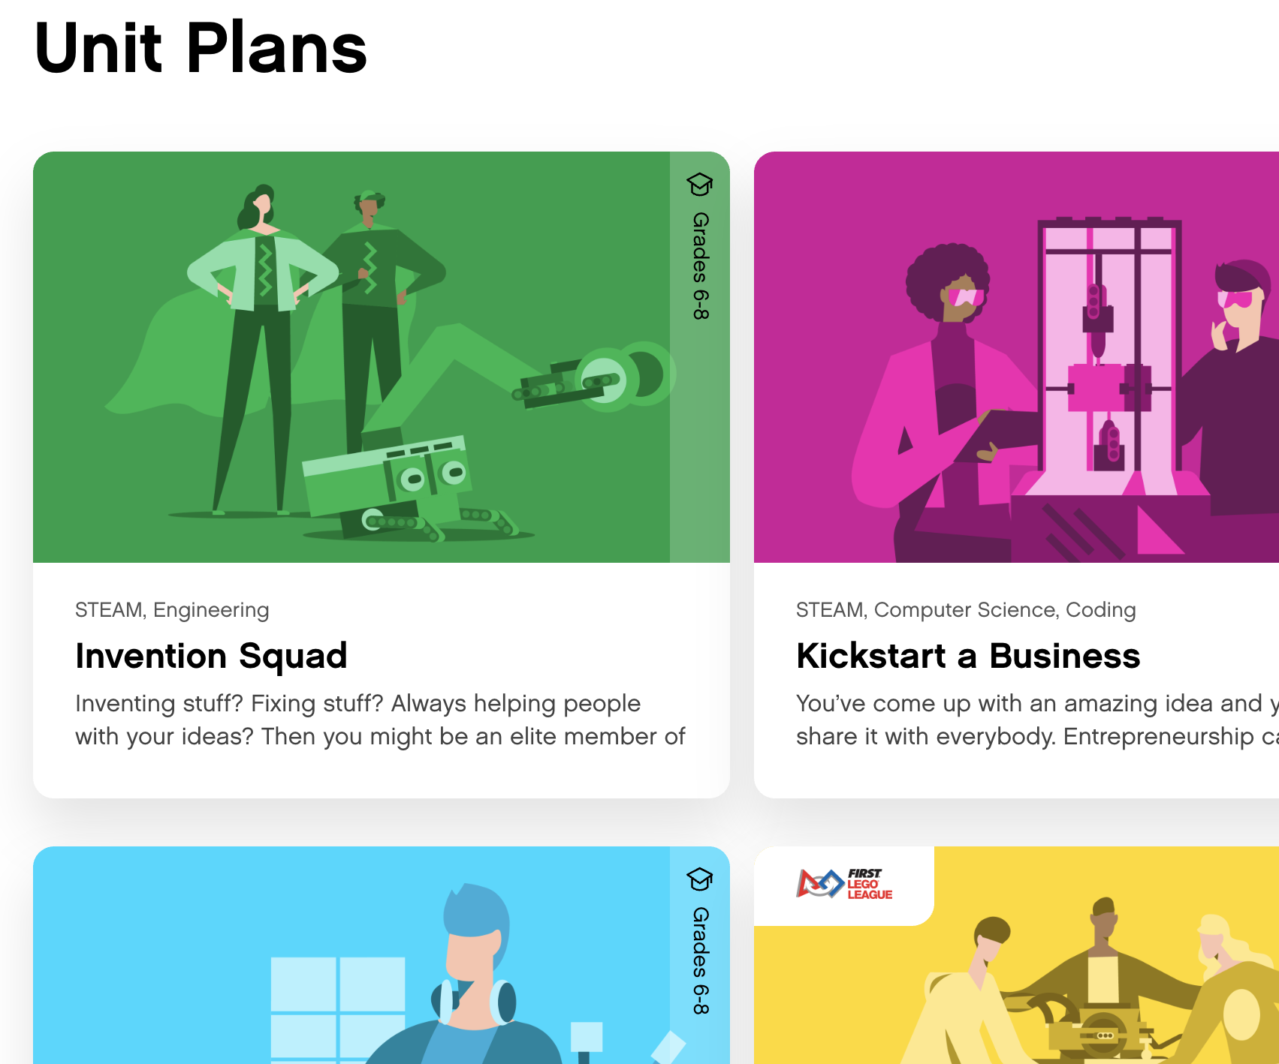
SPIKE Prime: Classroom Activity Based
Software takes you through 5 Units that have smaller models and guided lesson plans that can be completed in smaller classroom sessions
Includes a “Competition Ready” Unit for FIRST LEGO League teams (required Expansion set)

Slide 5
6 universal ports
Powered-up cables
5X5 LED Matrix
Yellow
Bluetooth and USB
Sensors: Distance 1, Color Force, built-in 6 axis gyro and accelerometer
Distance Sensor with break-out interface
Motors: 2 medium; 1 large (light azure)
Storage Box

Slide 6
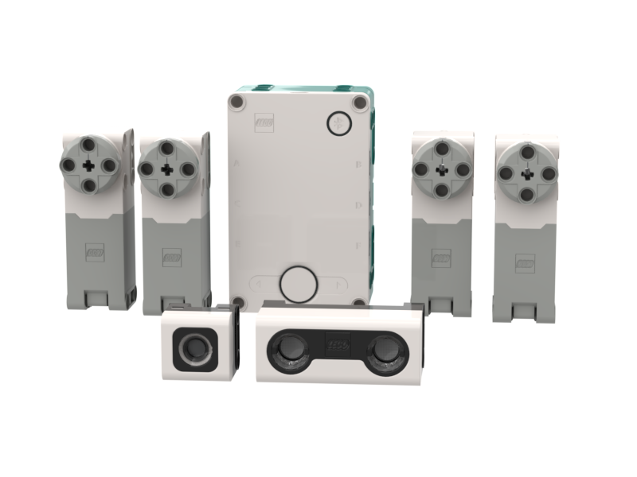
6 universal ports
Powered-up cables
5X5 LED Matrix
Teal
Bluetooth and USB
Sensors: Distance, Color, built-in 6 axis gyro and accelerometer
Distance Sensor with break-out interface
Motors: 4 medium (light grey)
No Storage Box

Slide 7
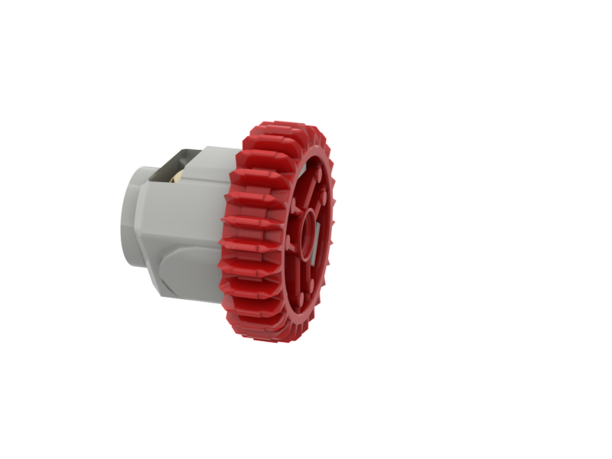
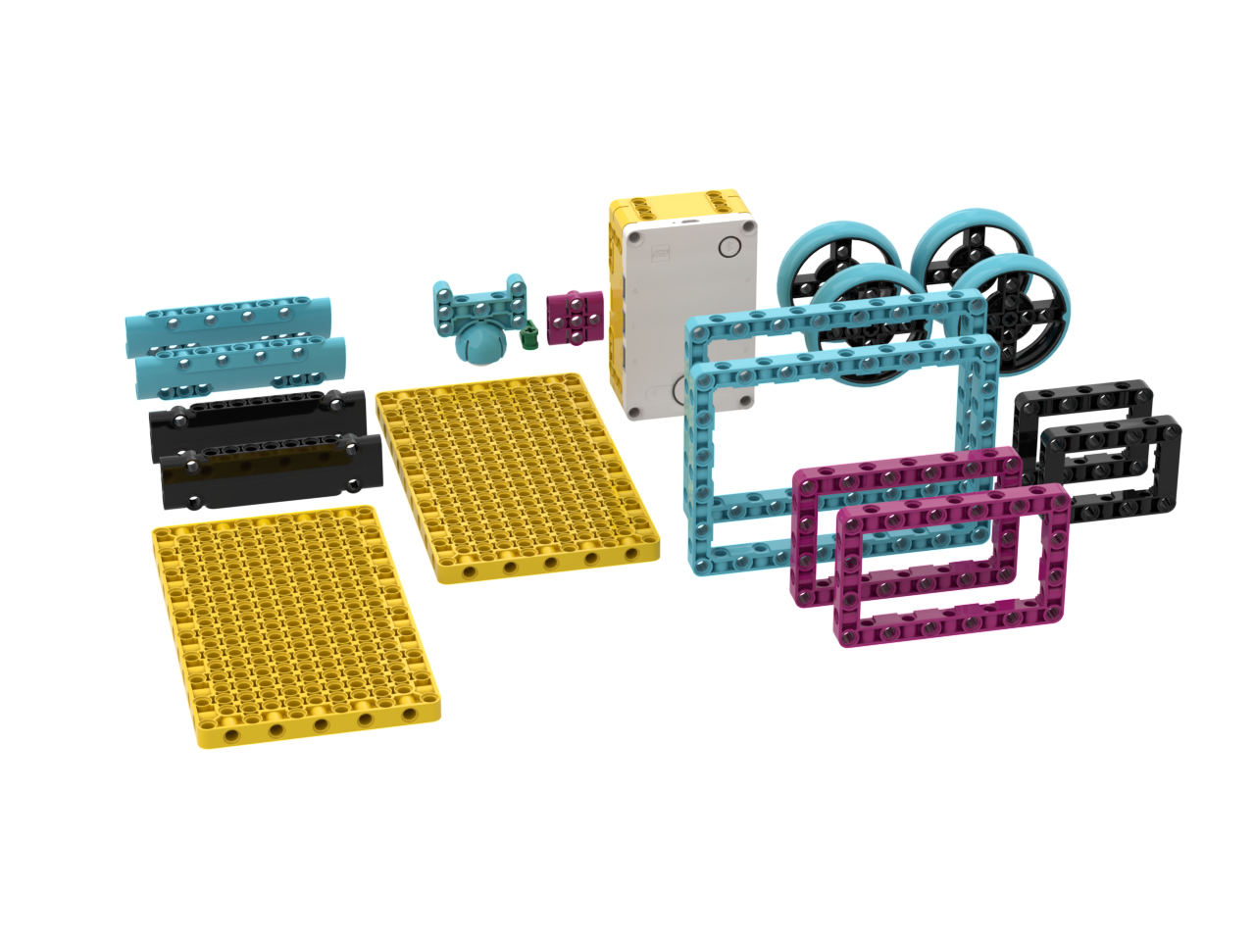
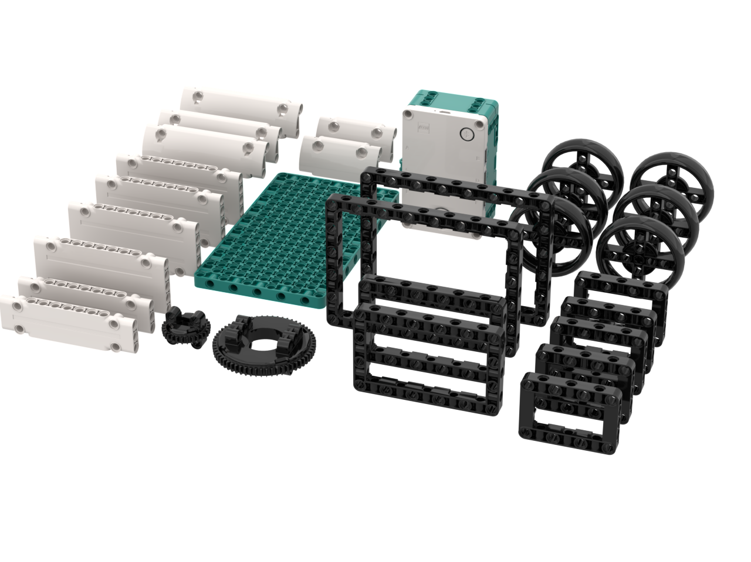
523 parts
Caster wheel
949 parts: More wheels, frames, and panels
New differential gear

Slide 8
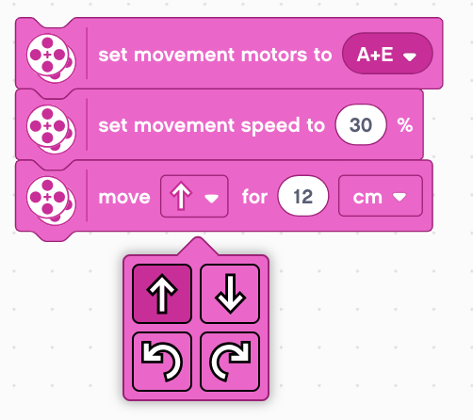
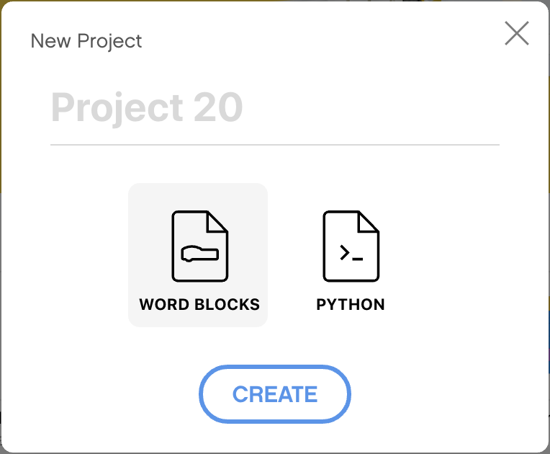
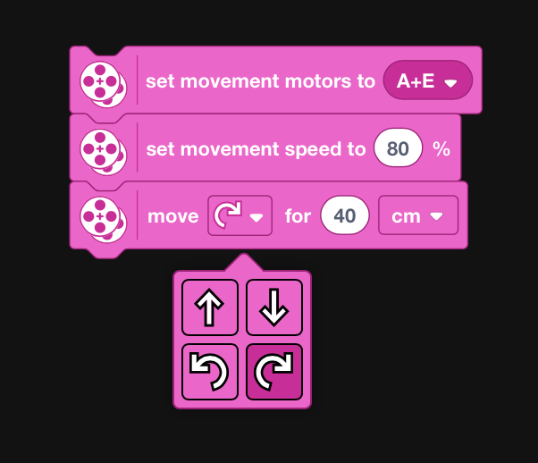
Word Blocks and Python
Light Background
No remote control
No custom blocks for models
Extensions to add more blocks
No hub-to-hub communication
No machine learning
Word Blocks and Python
Black background
Remote Control application
Custom Blocks for main models
Extensions to add more blocks
Hub-to-Hub Communication
Machine Learning

Slide 9
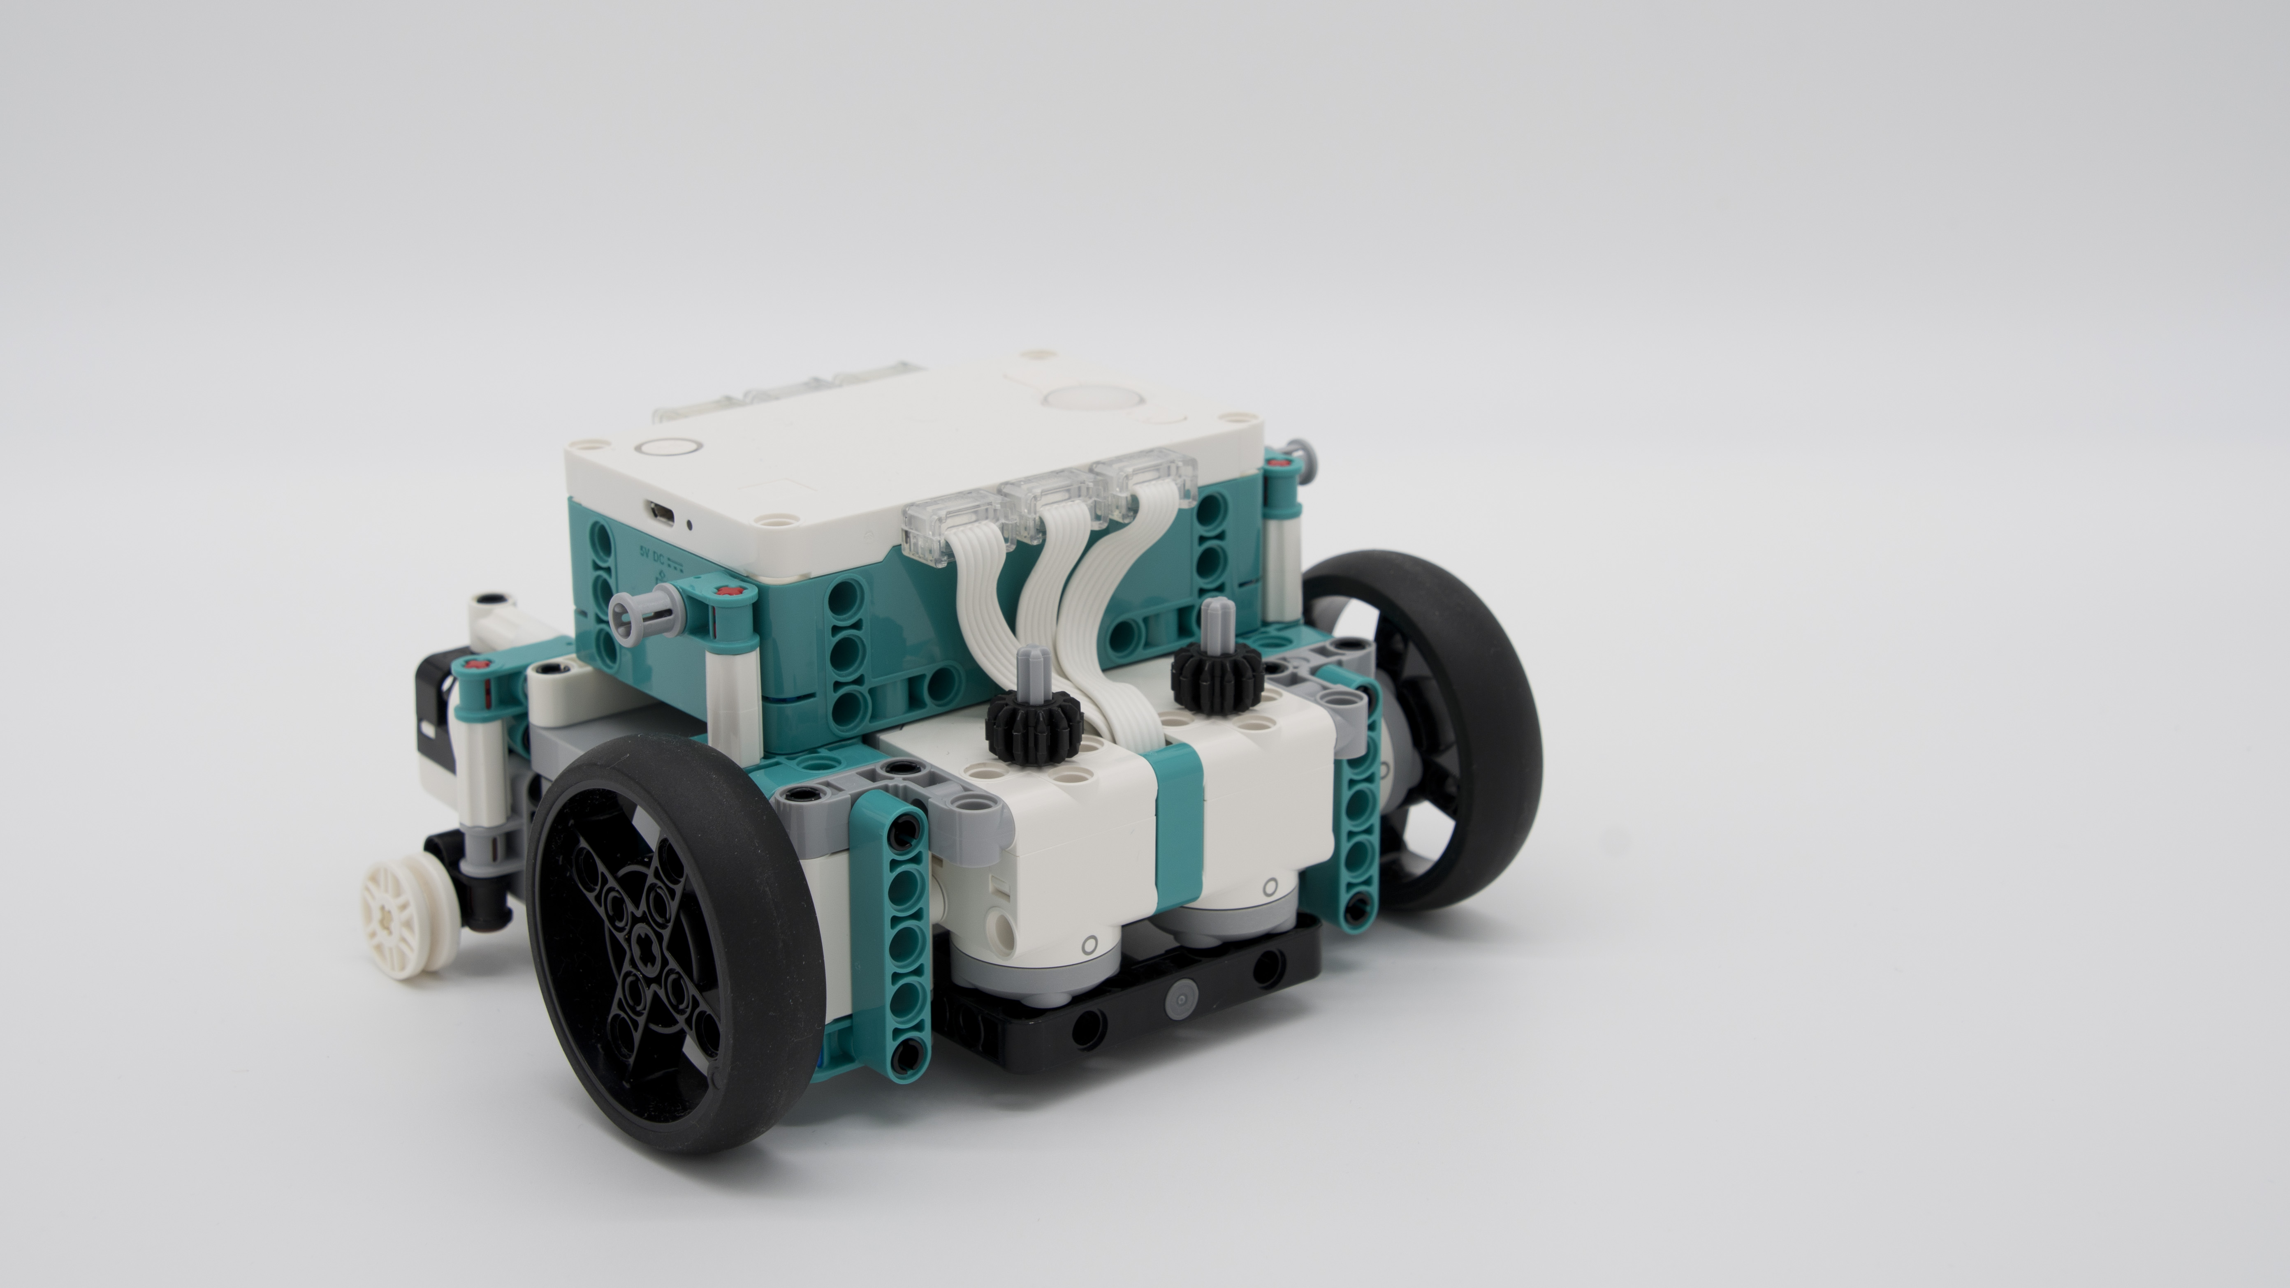
CAN YOU BUILD A COMPETITION ROBOT?
Robot Inventor is allowed in FIRST LEGO League Challenge starting in the RePLAY season.

Slide 12
FAQs
Can you use a SPIKE Prime large motor in a MINDSTORMS Hub?
Yes
Can you use MINDSTORMS motors/sensors on a SPIKE Prime Hub?
Yes
Can you convert a SPIKE Prime into a MINDSTORMS Hub or the reverse?
You were able to run either firmware on either Hub when using SPIKE 2. As far as we know, Robot Inventor is currently not supported in SPIKE 3.
Can you convert a program from SPIKE Prime to MINDSTORMS or the reverse?
You can change the extension of a SPIKE Prime 2 Program (.llsp) and have it open in the MINDSTORMS App. This has not be been confirmed with a .llsp 3 (SPIKE 3) file.
Is Robot Inventor still available?
The Robot Inventor MINDSTORMS set was retired at the end of 2022

Slide 13
CONTACT US
Watch: https://youtu.be/SxmeodiGyRc
Contact us: team@ev3lessons.com

