Slide 1
Managing Projects
BY SANJAY AND ARVIND SESHAN

Slide 2
Lesson Objectives
Learn how to create and name projects
Learn how to duplicate and delete projects
Learn how to copy code across projects
Learn how to order your projects on your Hub
Learn how to share project files

Slide 3
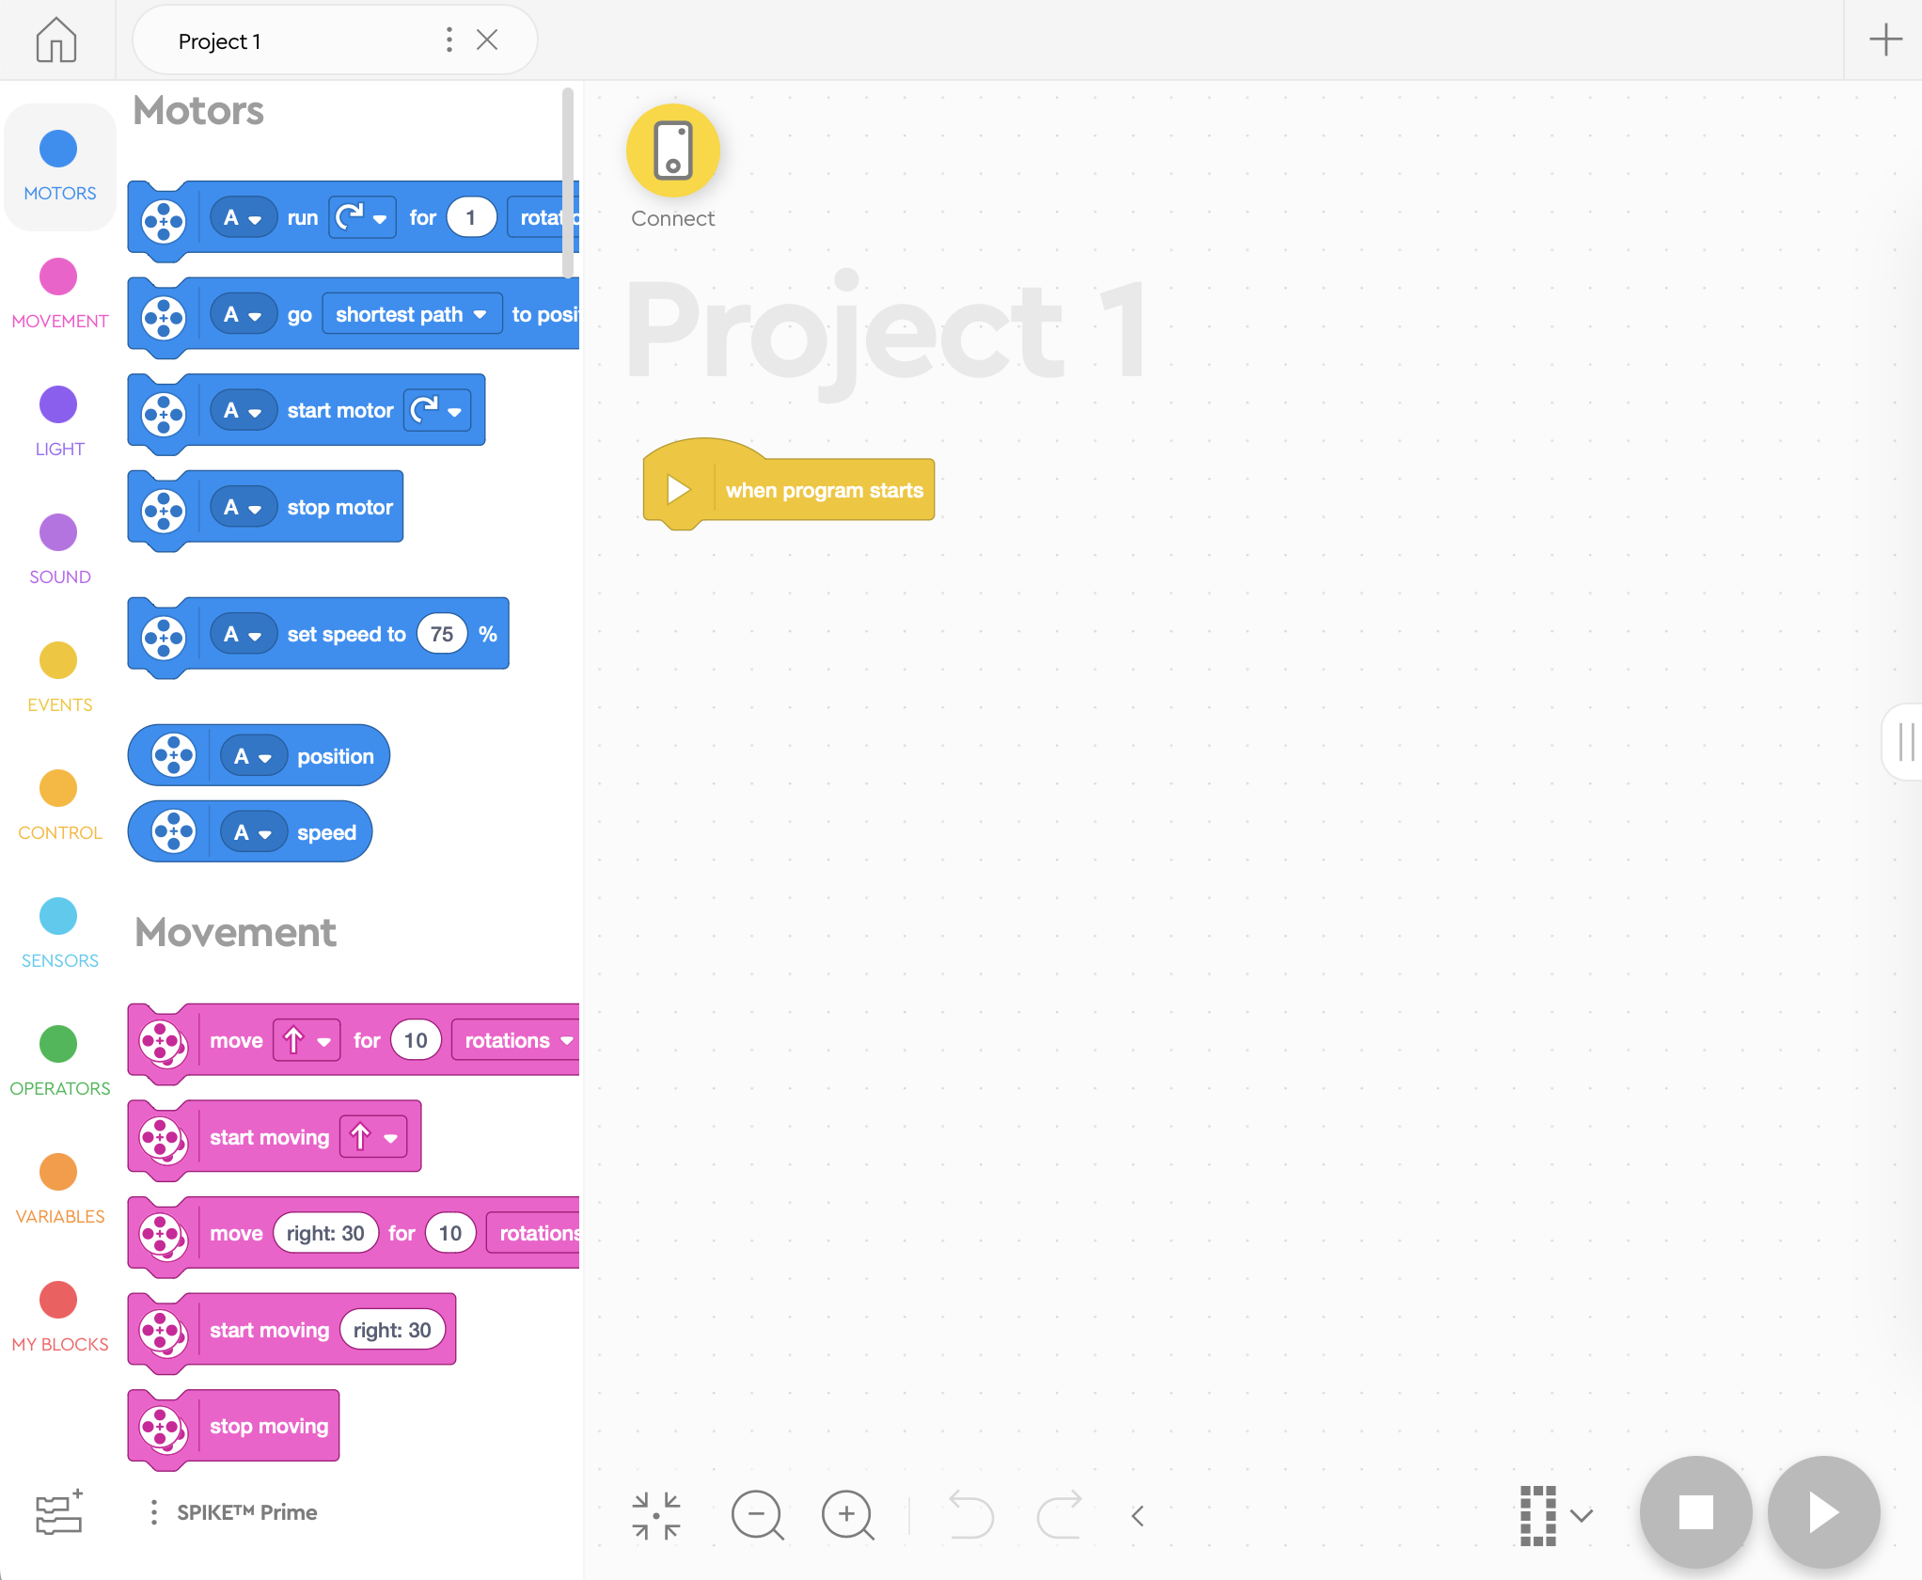
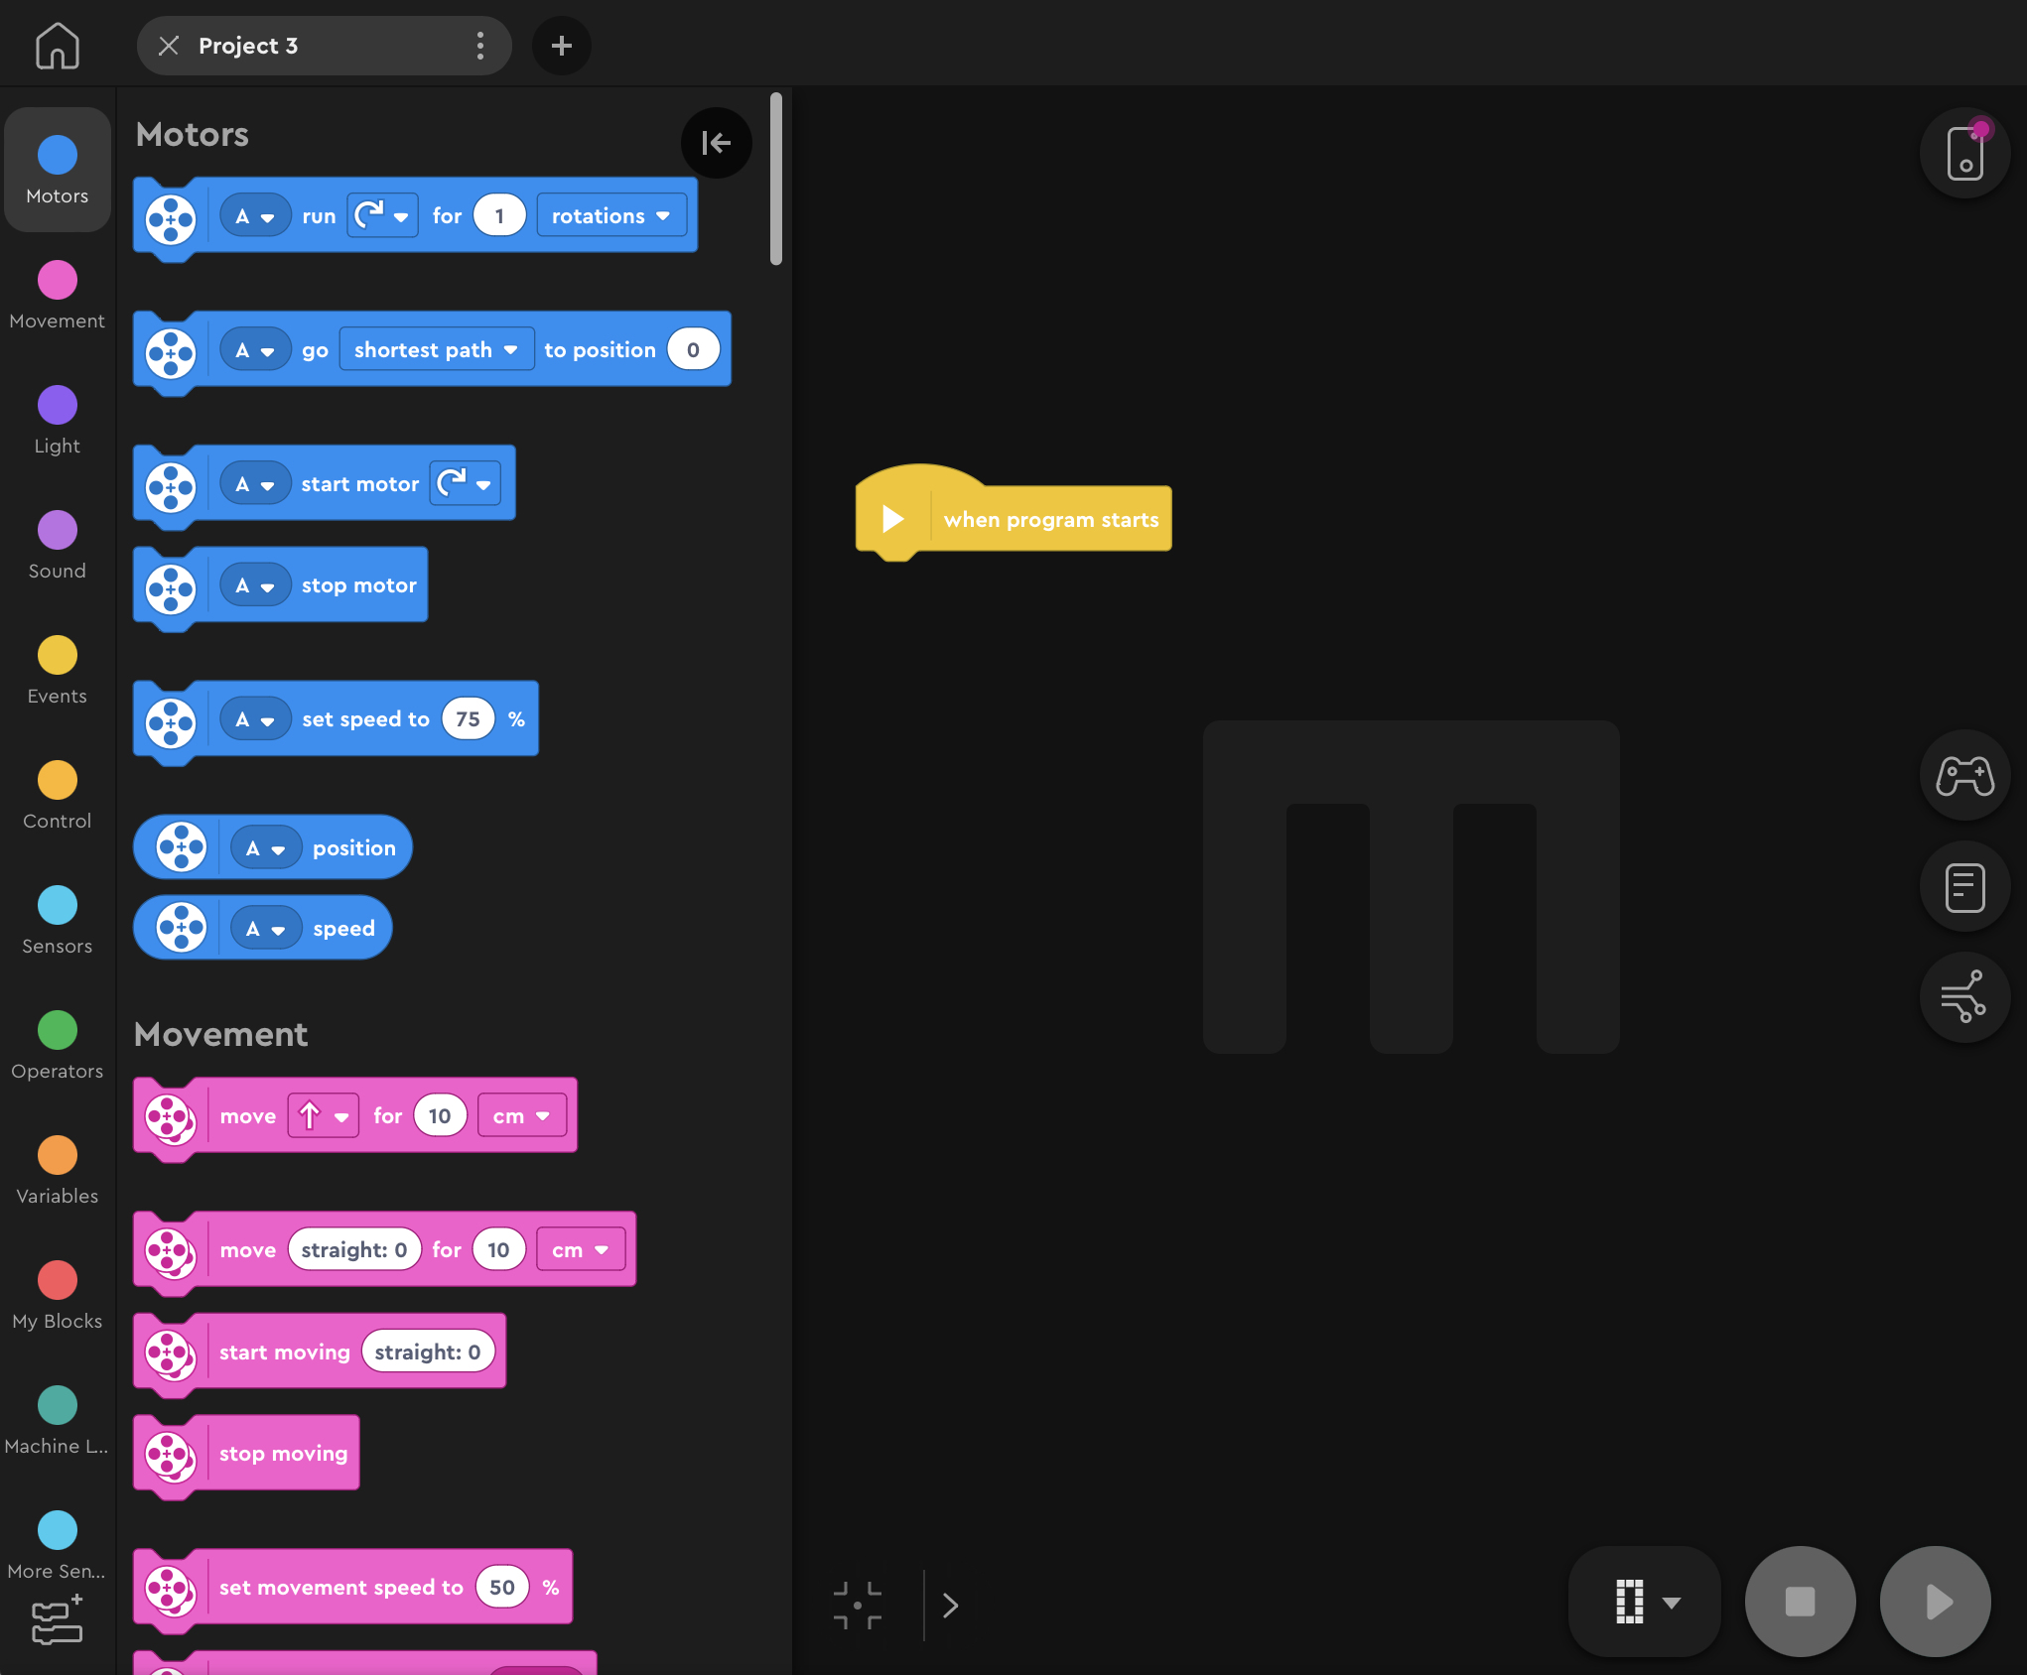
Create PROJECTS
To create a new project, click on the + sign in either SPIKE Prime or Robot Inventor

Slide 4
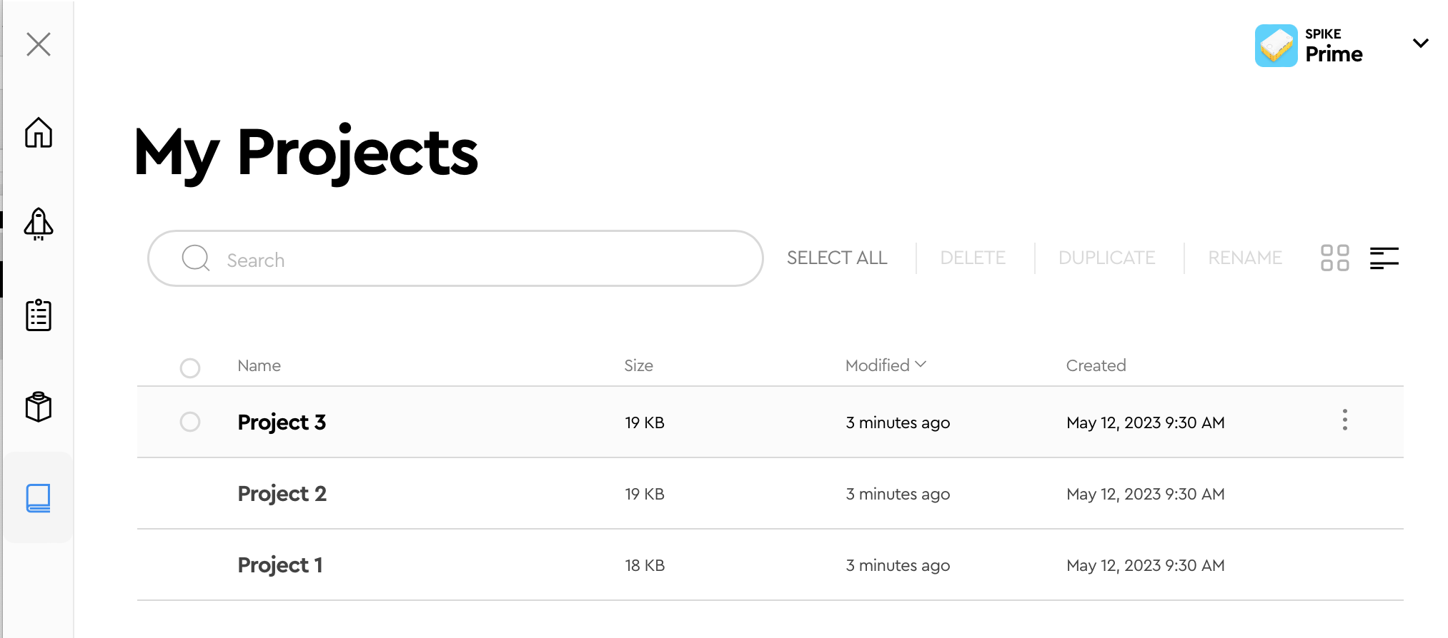
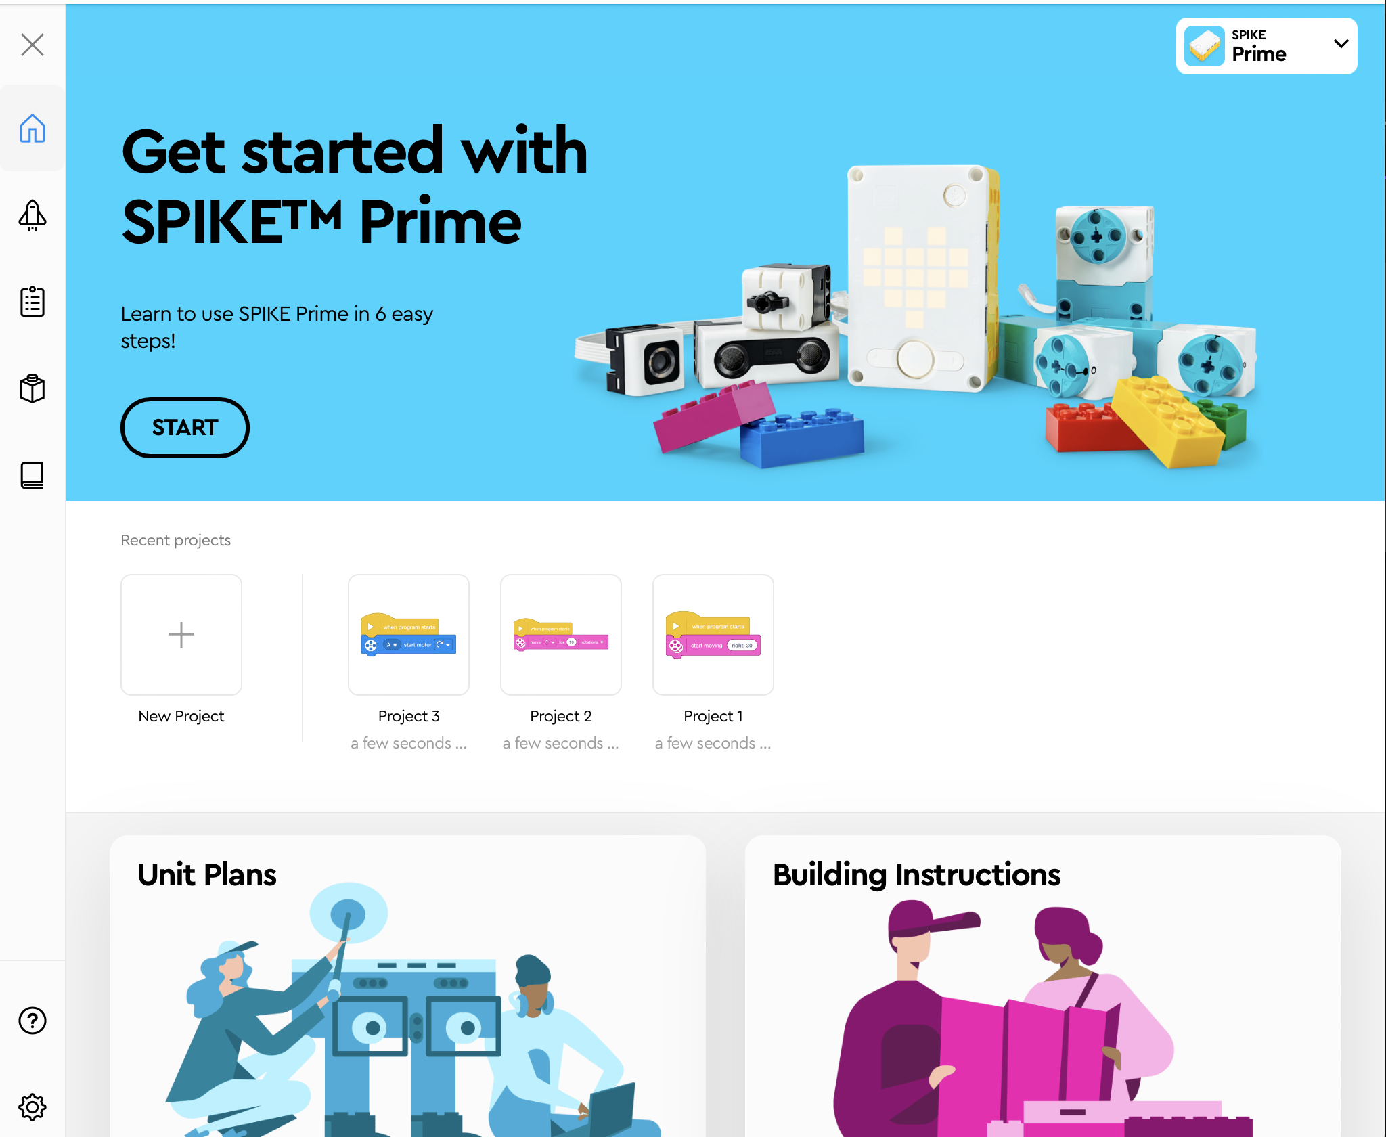
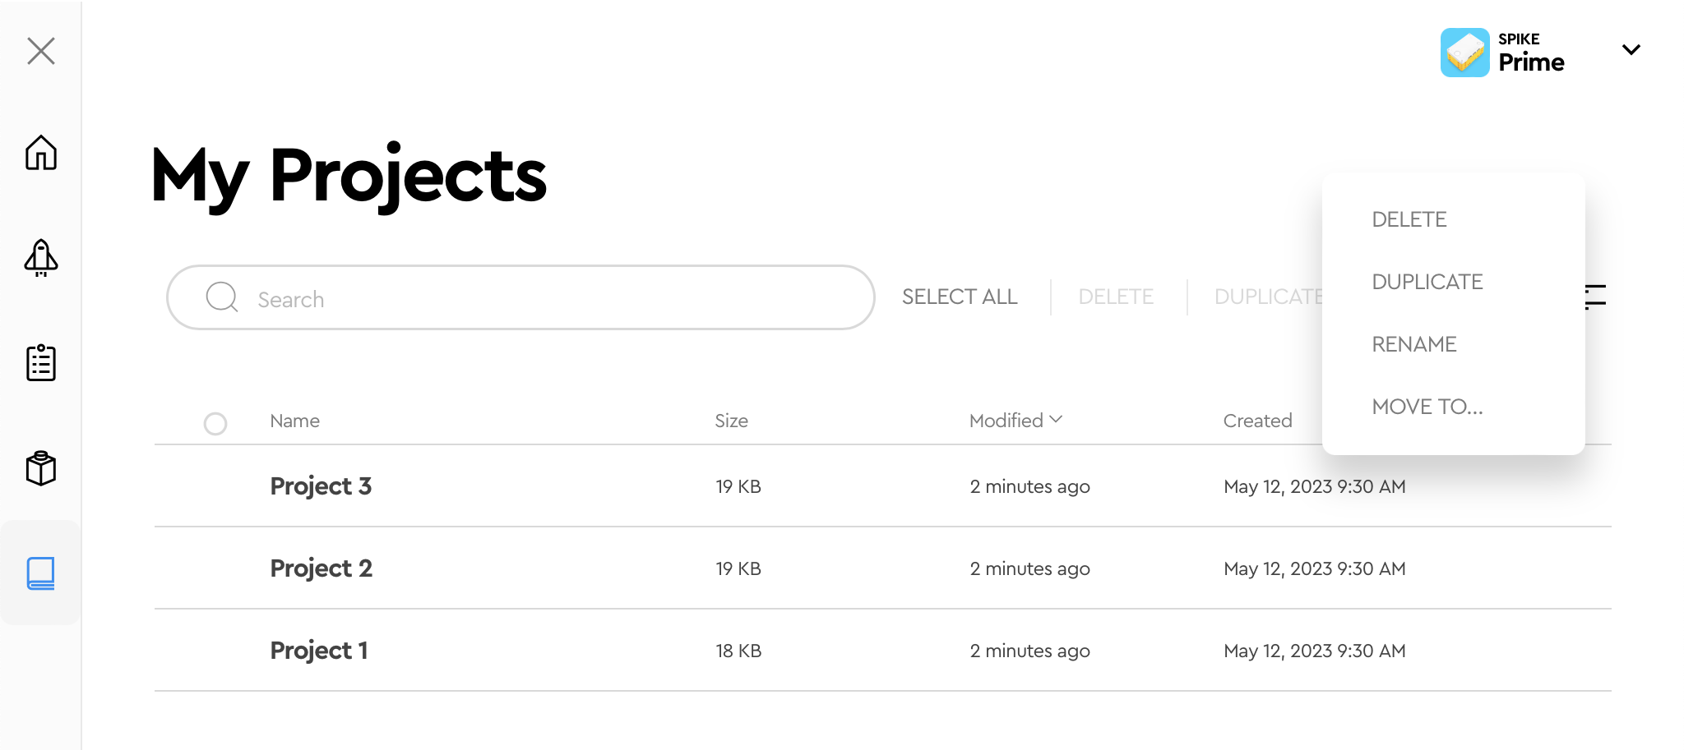
Delete, duplicate, rename in SPIKE PRIME
List/icon view
[1]
[2]
Click on “My Projects” to view a list of the projects you have made.
To edit an existing project click on the edit icon [2] and then select the project you want to modify. Select the desired action (delete or duplicate or rename or move) [3].
[3]

Slide 5
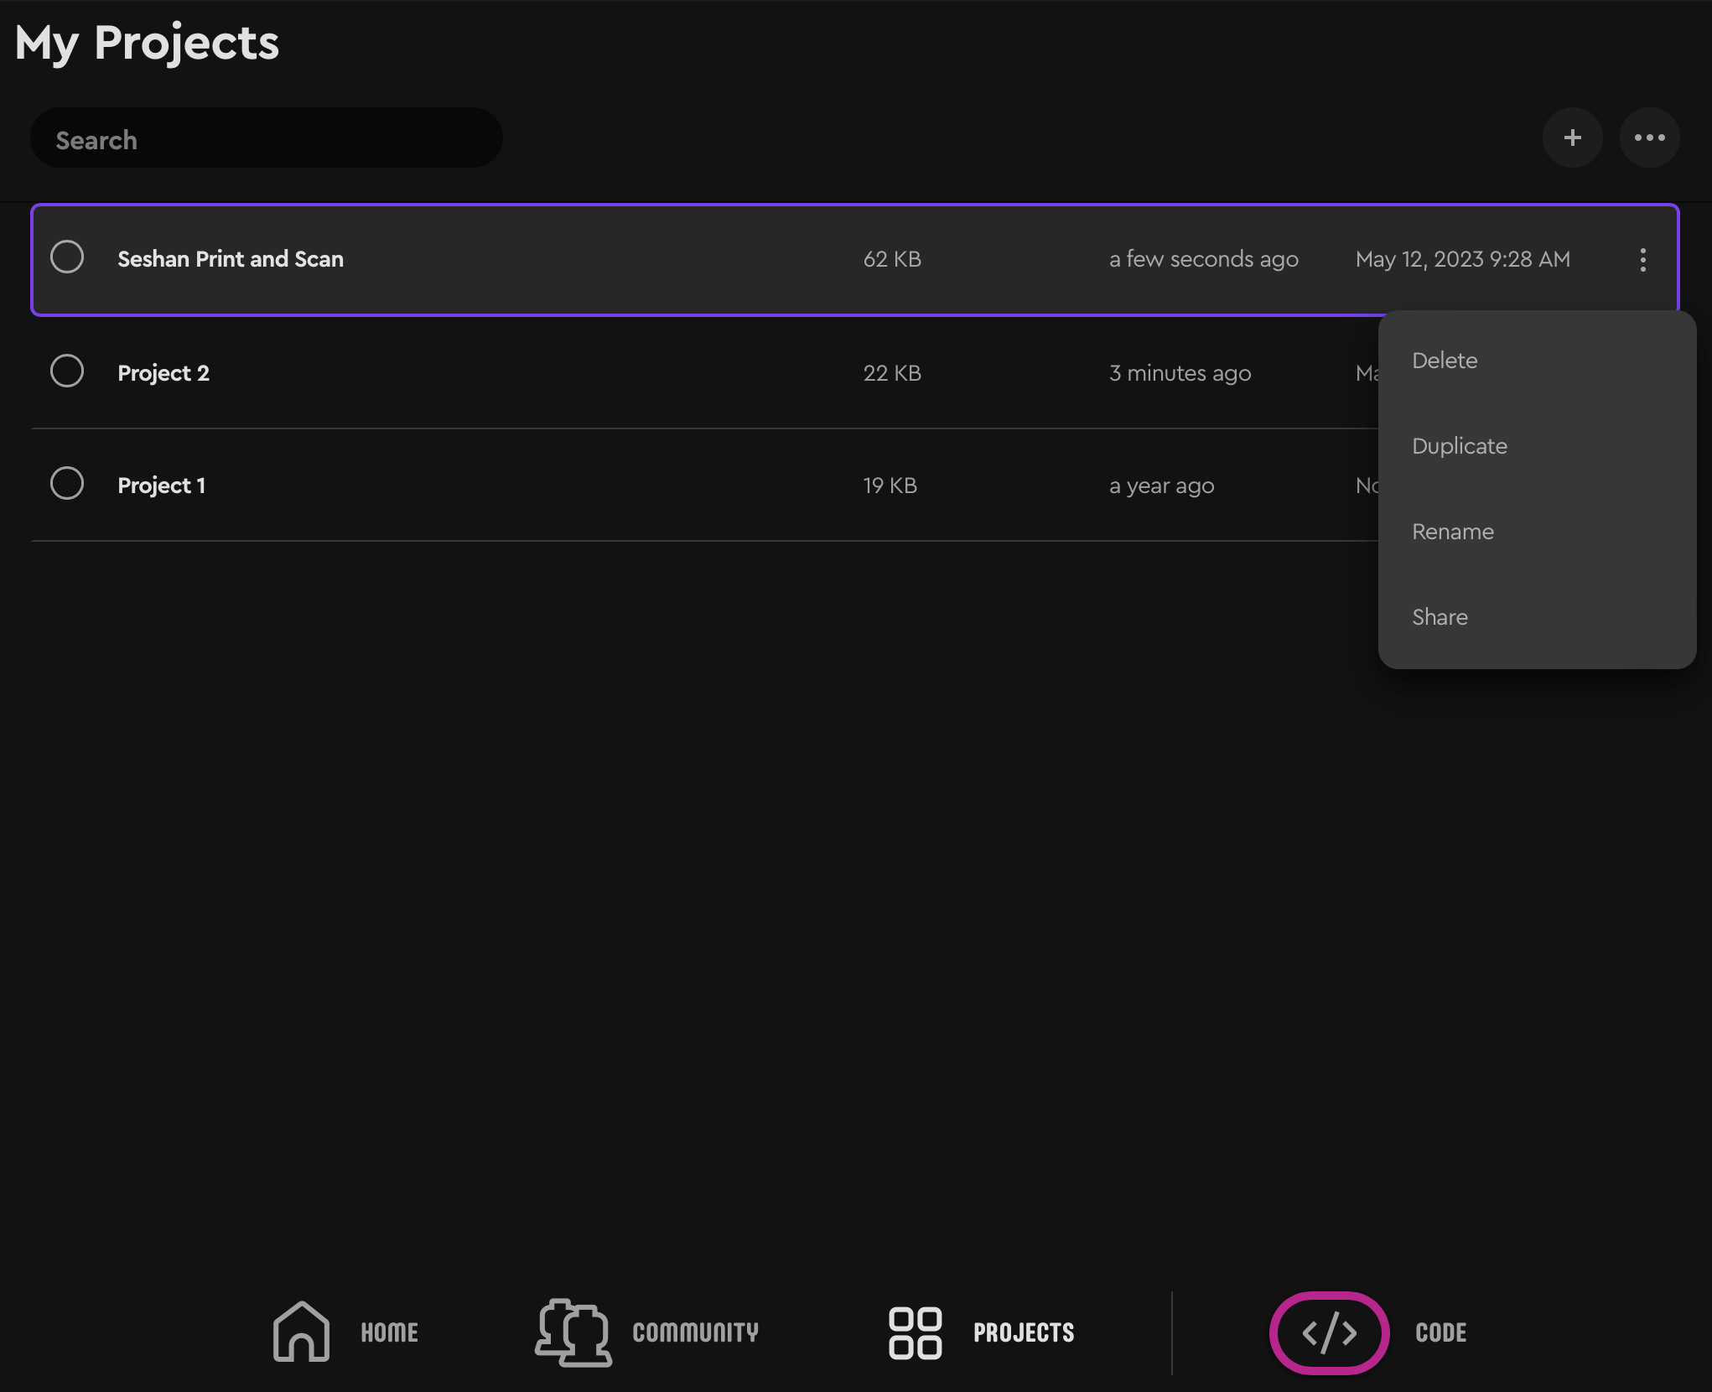
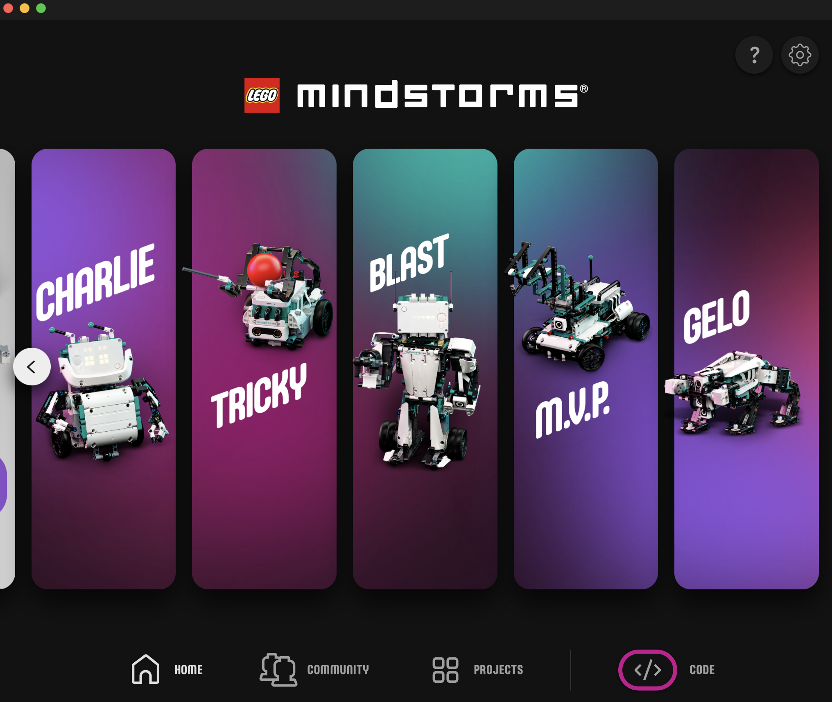
Delete, duplicate, rename IN ROBOT INVENTOR
List/icon view
[2]
[3]
[1]
Clicking on “Projects” at the bottom of the Home page shows a list of the projects you have made. [1]
To edit an existing project click on the edit icon (3 dots) [2] and then select the project you want to modify. Select the desired action (delete or duplicate or rename or share) [3].
[1]

Slide 6
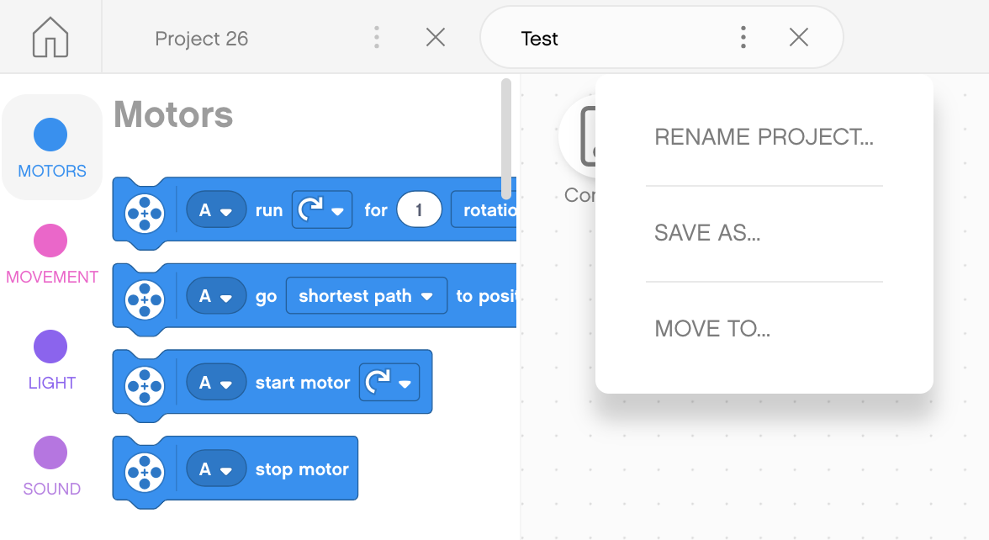
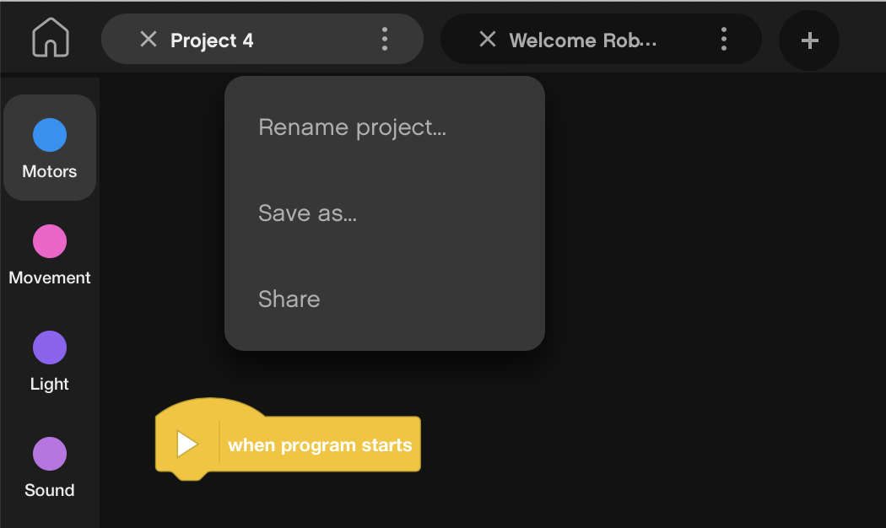
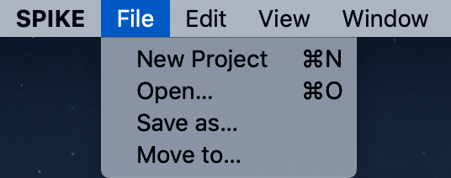
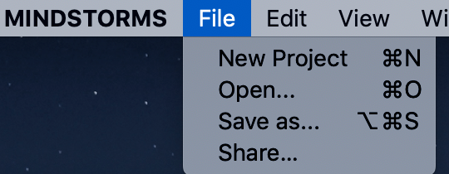
Another way to Rename projects
The three dots (…) next to the Project name in both SPIKE Prime and Robot Inventor lets you rename projects and also save them to a different location
Note: Robot Inventor lets you also share projects this way
Some of these options are available from the App menu as well

Slide 7
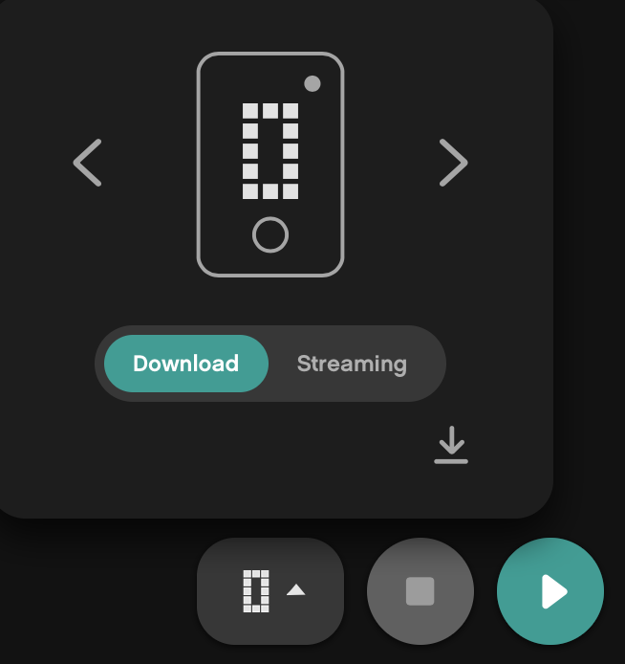
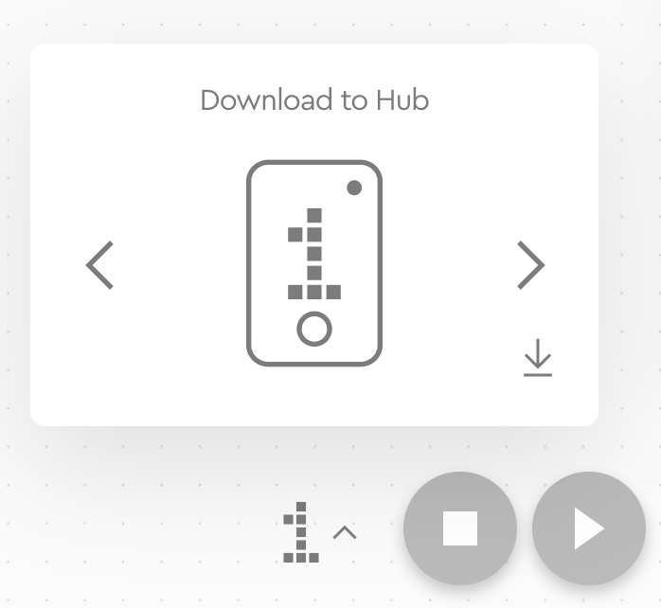
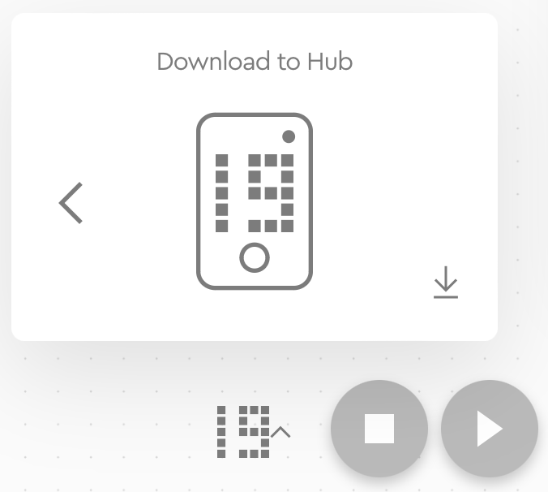
Ordering projects ON THE HUB
Download/Run
The Download Icon lets you select what “slot” on the Hub you want your project to be saved in
Use the right arrow to change the number from 0 to any number between 0-19
The Hub can store up to 20 programs
This feature is available on both SPIKE Prime and Robot Inventor
…

Slide 8
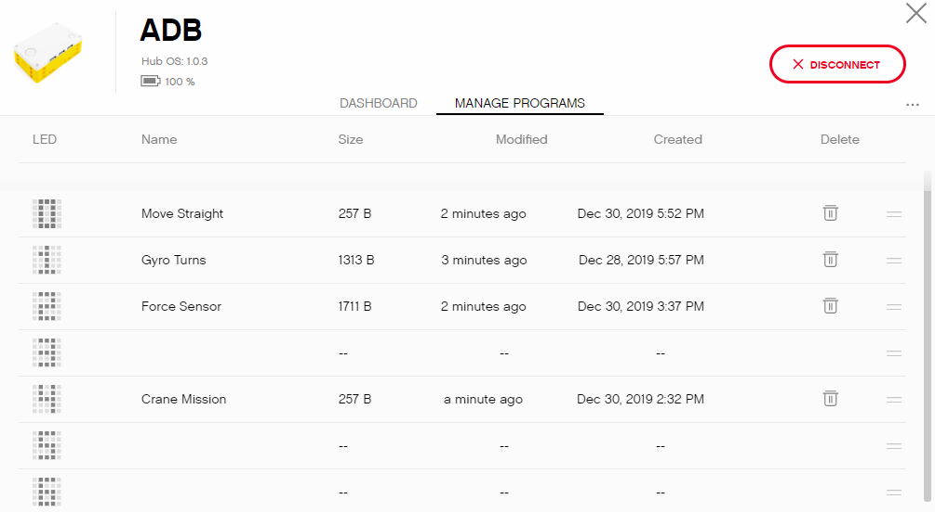
CHANGING THE ORDER OF PROJECTS (SPIKE PRIME)
NOT AVAILABLE IN SP3
Step 1: Click on the Hub icon
Step 2: Click on “Manage Programs”
Step 3: Click on the two bars icon (=) in each row to drag the program to a new position. Use the trashcan icon to delete

Slide 9
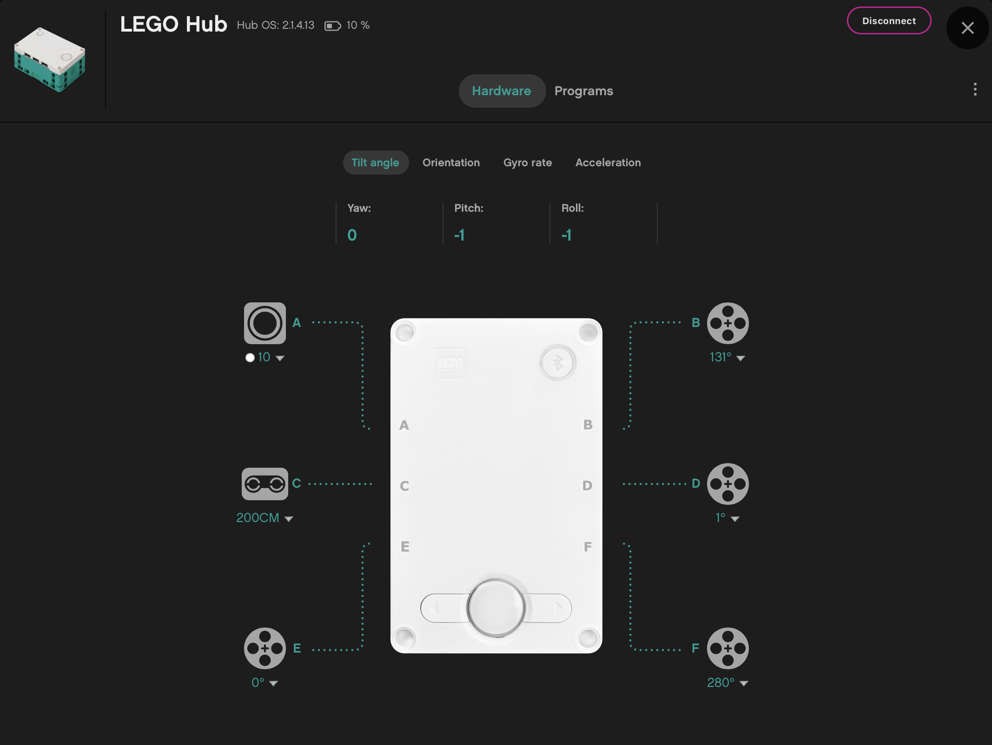
CHANGING THE ORDER OF PROJECTS (ROBOT INVENTOR)
Step 1: Click on the Hub icon
Step 3: Click on the two bars icon (=) in each row to drag the program to a new position. Use the trashcan icon to delete
Step 2: Click on “Programs”

Slide 10
Sharing projects IN SPIKE PRIME
SPIKE Prime files have a .llsp (SPIKE 2) or .llsp3 (SPIKE 3) extension.
You can find all the files saved in your My Documents folder
You can email or share these files with anyone via email, etc.
Projects do auto-save, however, it is good practice to backup your project files often since you cannot recover files from the Hub to your computer later

Slide 11
Sharing projects IN ROBOT INVENTOR
Robot inventor files have an .lms extension
Projects auto-save. However, if you want to change the name and location of the saved file, you can do so using the three dots next to the Project name.
Sharing projects in Robot Inventor is very easy. The three dots next to the Project name has a Share button or you can locate the correct .lms file and share it with someone
You can access these same features also from the menu

Slide 12
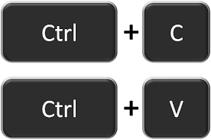
Copying code between projects IN SPIKE PRIME
Click on the program stack you wish to copy to another project
Hit CTRL-C to Copy the stack (⌘ Command-C on Mac OS X)
Go to the other project file and hit CTRL-V (PASTE) (⌘ Command-V on Mac OS X)
Unfortunately, using COPY-PASTE across projects does not work in Robot Inventor

Slide 13
CREDITS
This lesson was created by Sanjay Seshan and Arvind Seshan for Prime Lessons
More lessons are available at www.primelessons.org
This work is licensed under a Creative Commons Attribution-NonCommercial-ShareAlike 4.0 International License.

