Slide 1
moving objects & Stall Detection
Sanjay and Arvind Seshan
This lesson uses SPIKE 2 software – Stall Detection Blocks are not available in SPIKE 3

Slide 2
Lesson Objectives
Learn how to move non-drive motors
Learn about motor stalls
Note: Images in the lesson may show a SPIKE Prime, but the same technique works on Robot Inventor

Slide 3
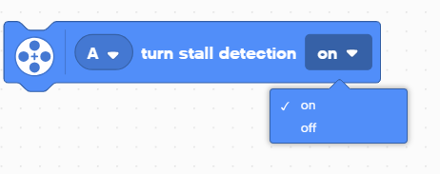
Stall detection
Often times, you program the motor to move a particular amount. However, the motor gets stuck before it reaches that amount.
Stall Detection allows your program to automatically move on to the next block in the stack when a particular motor block is stuck (unable to complete its move)
SPIKE Prime and Robot Inventor have a built-in Stall Detection
By default, Stall Detection is on for your blue motor blocks. However, you can turn this feature off using the Turn Stall Detection Block in the Motor Motors Palette (use Extensions to add the block)

Slide 4
NEGATIVE Values
You can enter negative values for power or distance
This will make the robot move backwards
If you negate two values (e.g. power and distance or distance and backwards direction), the robot will move forward.
Negative Power = Backwards
Positive Power = Forward

Slide 5
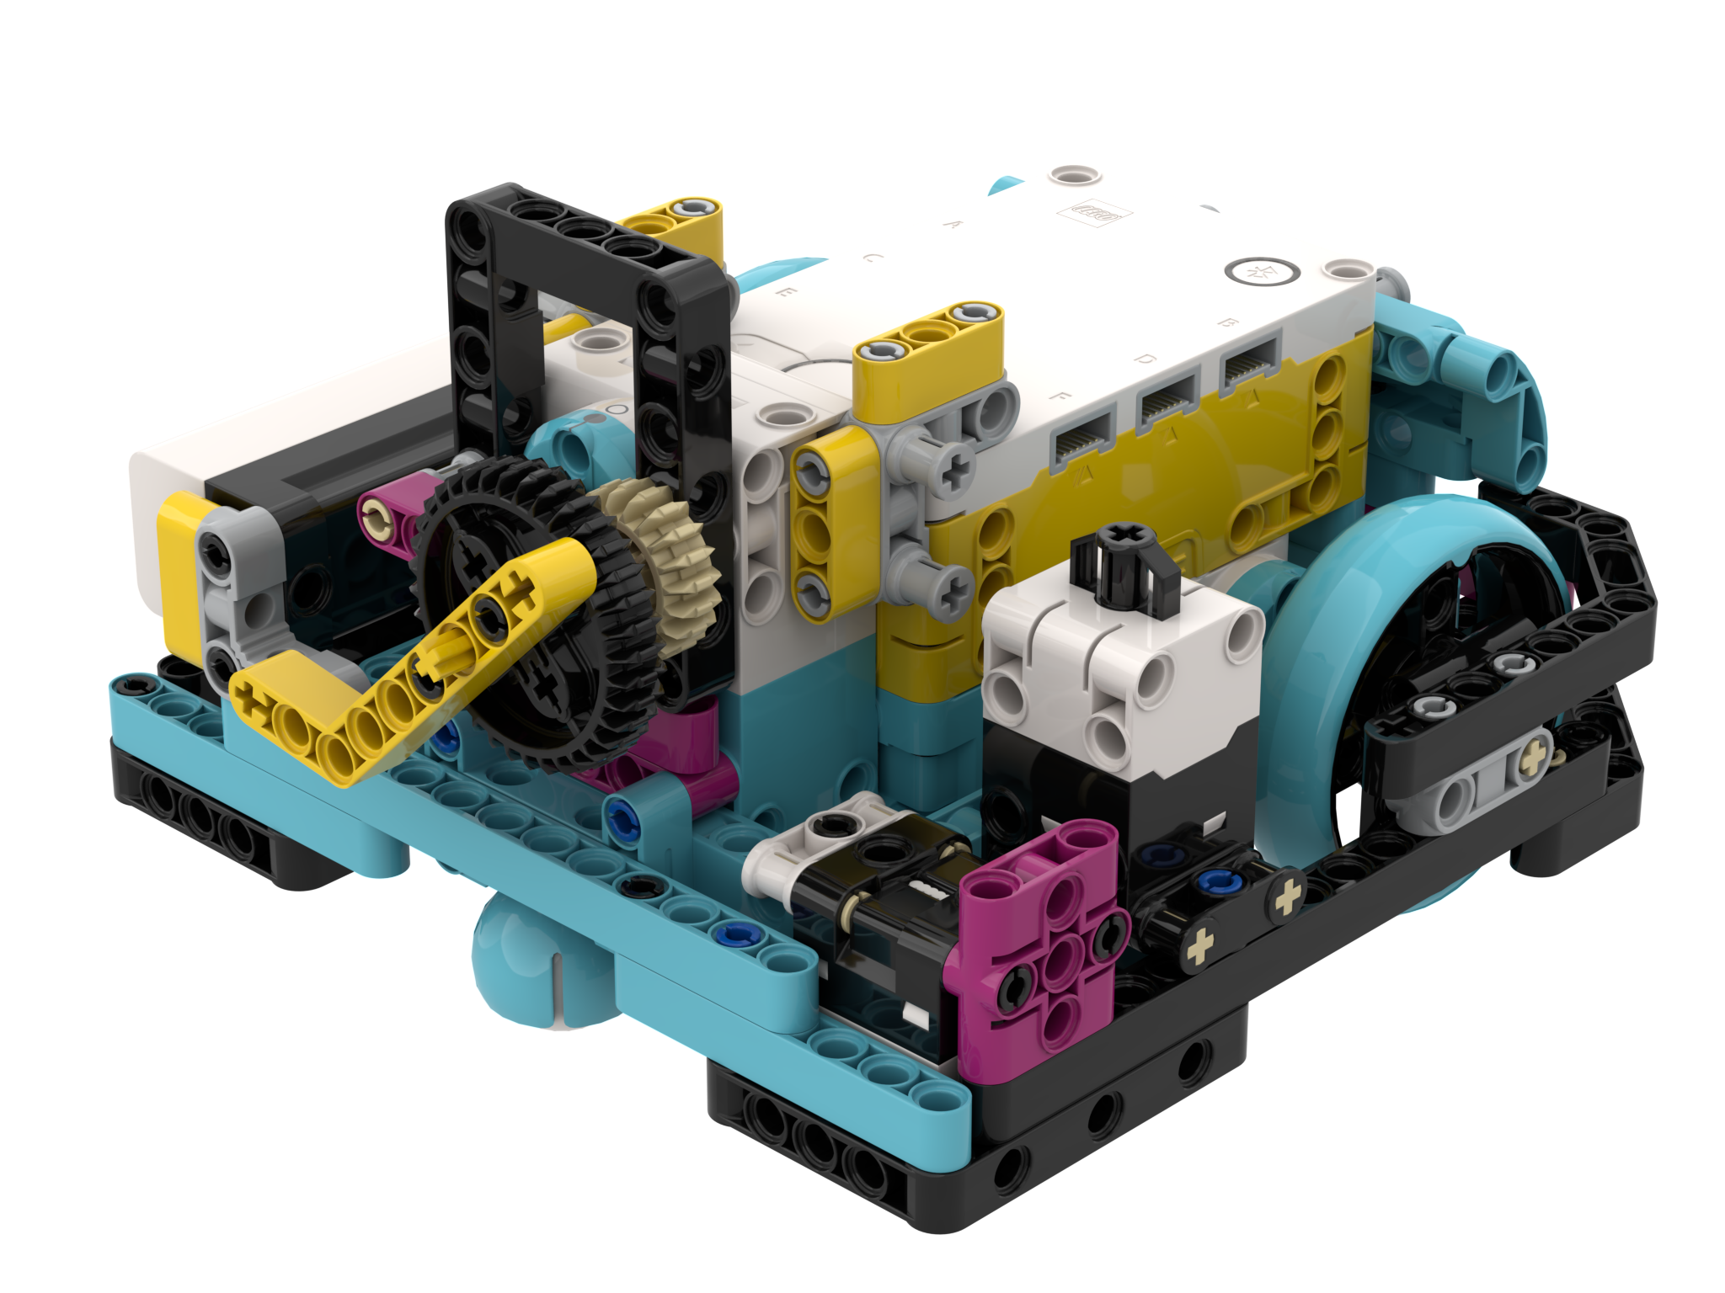
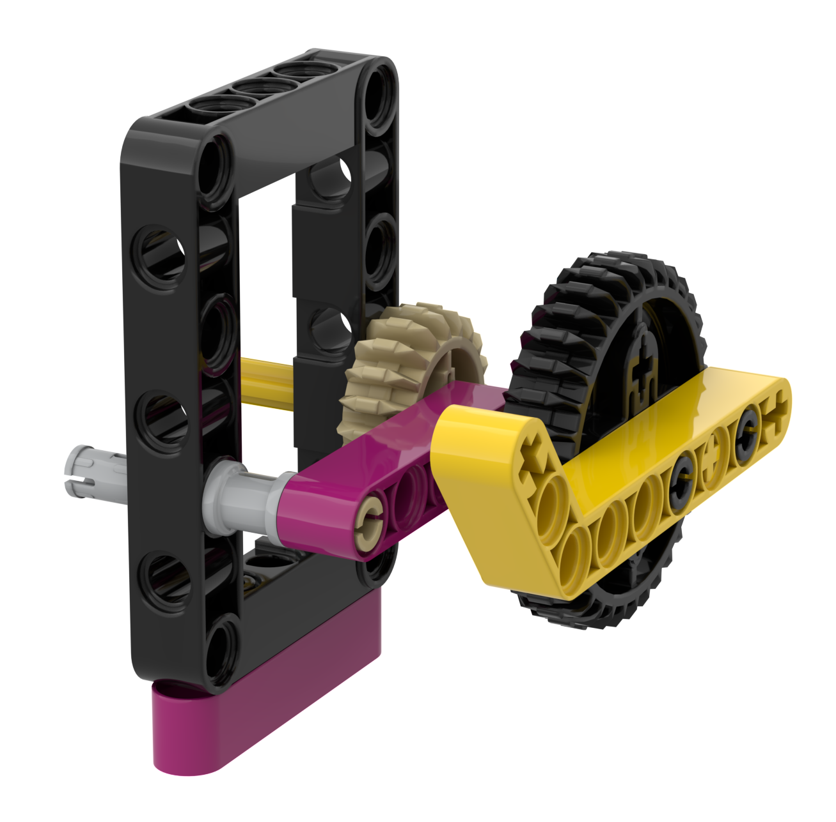
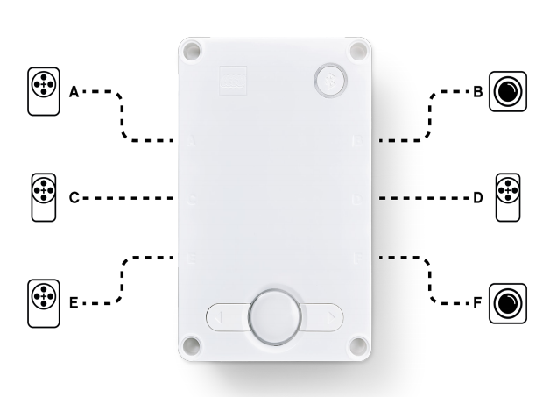
Attachment arm
Create a simple attachment arm for Droid Bot IV for the Large Motor connected to Port D
Droid Bot IV Configuration

Slide 6
Challenge 1: Learn about stall with DROID Bot IV
Create one program with stall detection turned on and one with stall detection turned off.
Using Droid Bot IV or similar, program the arm to turn 1000 degrees.
Hold the arm with your hand to prevent motor from completing 1000 degrees. Hold for a couple of seconds.
Compare what happens in each program. Will the cat meow play in both or only one program?
Cause a stall by holding the liftarm and preventing it from turning. Hold if for a second of two

Slide 7
Challenge 1 solution
Stall detection “on” allowed the code to move on to the next block even when the arm got stuck
The cat meow sound plays even if you hold the arm and prevent it from moving.
The cat meow sound will not play until you release the arm and allow the motor to complete its move

Slide 8
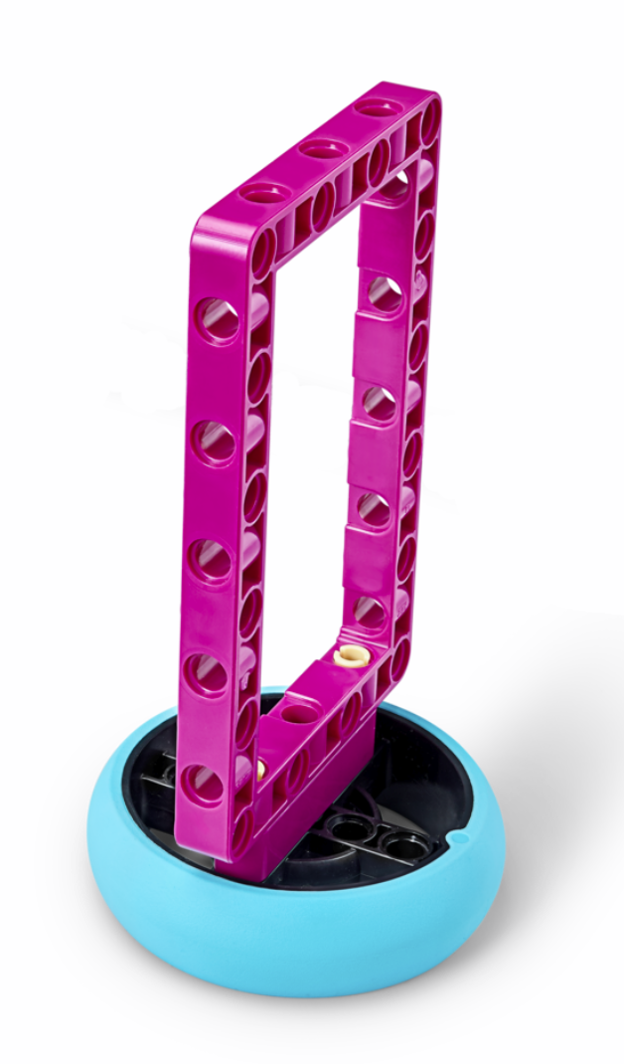
Challenge 2: Pick up object (ADB challenge)
Drive forward, pick up a hoop and return to the start
Make sure to use stall detection in case the motor gets stuck while trying to collect the hoop

Slide 9
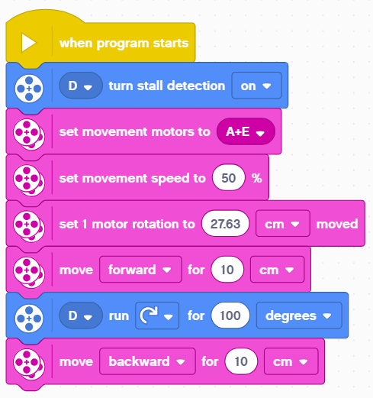
Challenge 2 solution
Turn stall detection on in case it was turned off in an earlier program
Configure your robot as needed. This program is configured for the ADB robot and large SPIKE Prime tires.
Move forward up to your object
Rotate the arm up to pick up the hoop
Move back to starting point

Slide 10
Extensions
Think about situations in FIRST LEGO League when stall detection would be helpful
When might the robot get stuck?

Slide 11
CREDITS
This lesson was created by Sanjay Seshan and Arvind Seshan for SPIKE Prime Lessons
More lessons are available at www.primelessons.org
This work is licensed under a Creative Commons Attribution-NonCommercial-ShareAlike 4.0 International License.

