Slide 1
Introduction to SPIKE PRIME/ ROBOT INVENTOR HUB & software
BY SANJAY AND ARVIND SESHAN

Slide 2
Lesson Objectives
Learn how the SPIKE Prime and Robot Inventor Hub operates
Learn about the main components of the SPIKE Prime and Robot Inventor Software
Learn how to connect your Hub

Slide 3
The Hub Buttons
Put Hub in Bluetooth pairing mode
Left button for program navigation in home menu
Select program or exit program when running. Hold down for 5 seconds to power off. Turns on Hub.
Right button for program navigation
1
3
2
4

Slide 4
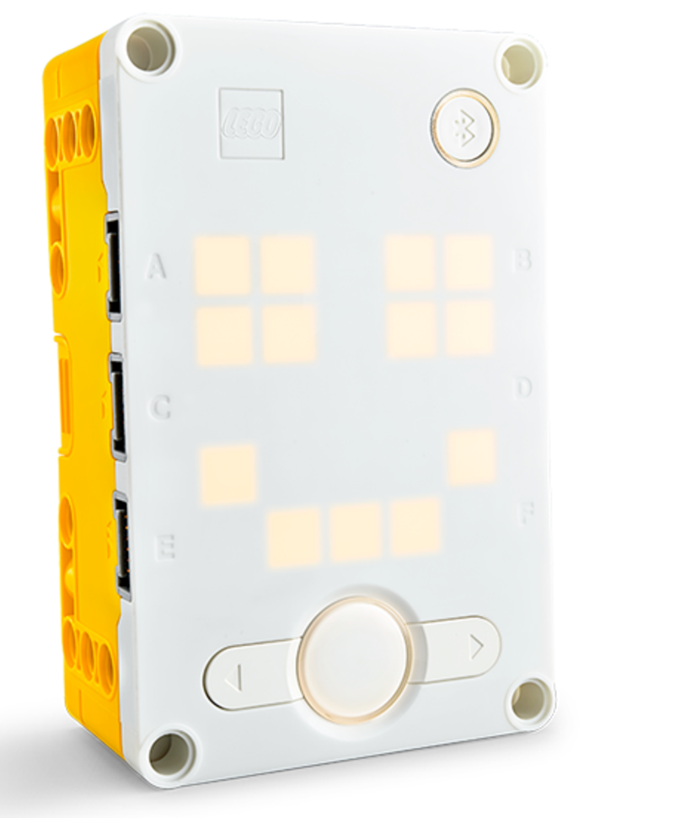
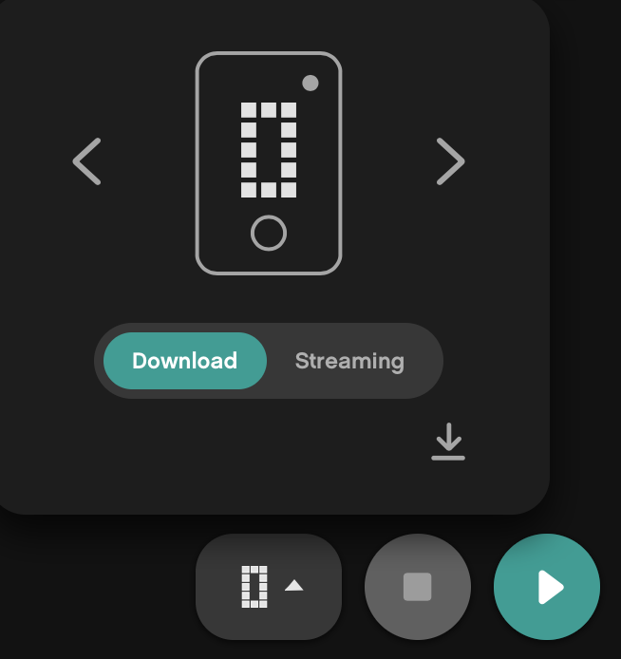
The Hub screen
5x5 LED pixel matrix can be used to make designs, but also pick programs
Use the arrows and center button to navigate/launch programs
You can have a maximum of 20 programs

Slide 5
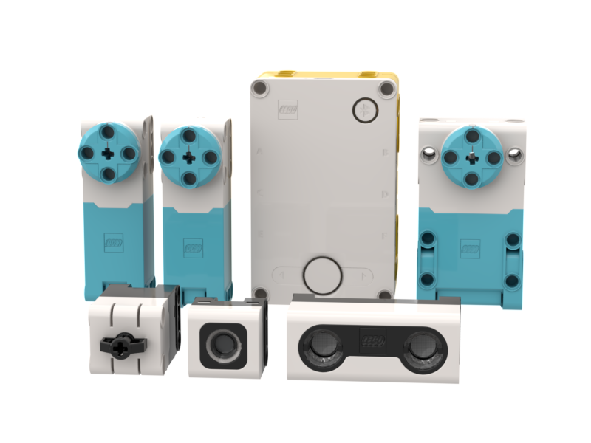
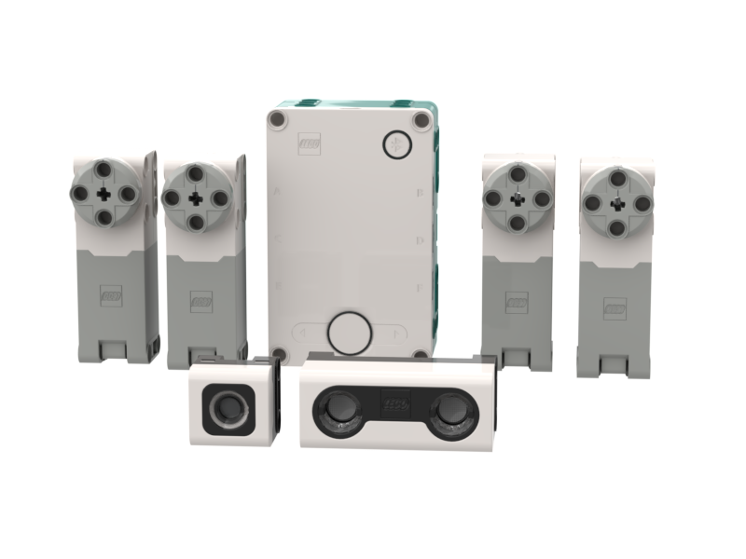
Ports, Motors and sensors
The hub has 6 built-in ports (A-F)
Any port can be used for any motor or sensor
The main SPIKE Prime set comes with 1 Large Motor and 2 Medium Motors, 1 Force Sensor, 1 Distance Sensor, 1 Color Sensor, and a built-in 6-axis IMU (3-axis accelerometer + 3-axis gyro)
The Robot Inventor set comes with 4 Medium Motors, 1 Distance Sensor, 1 Color Sensor, and a built-in 6-axis IMU (3-axis accelerometer + 3-axis gyro)

Slide 6
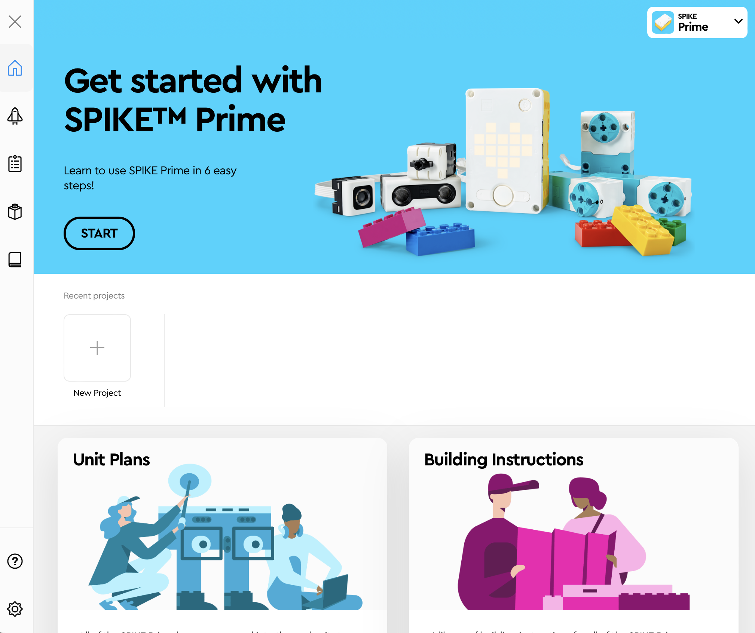
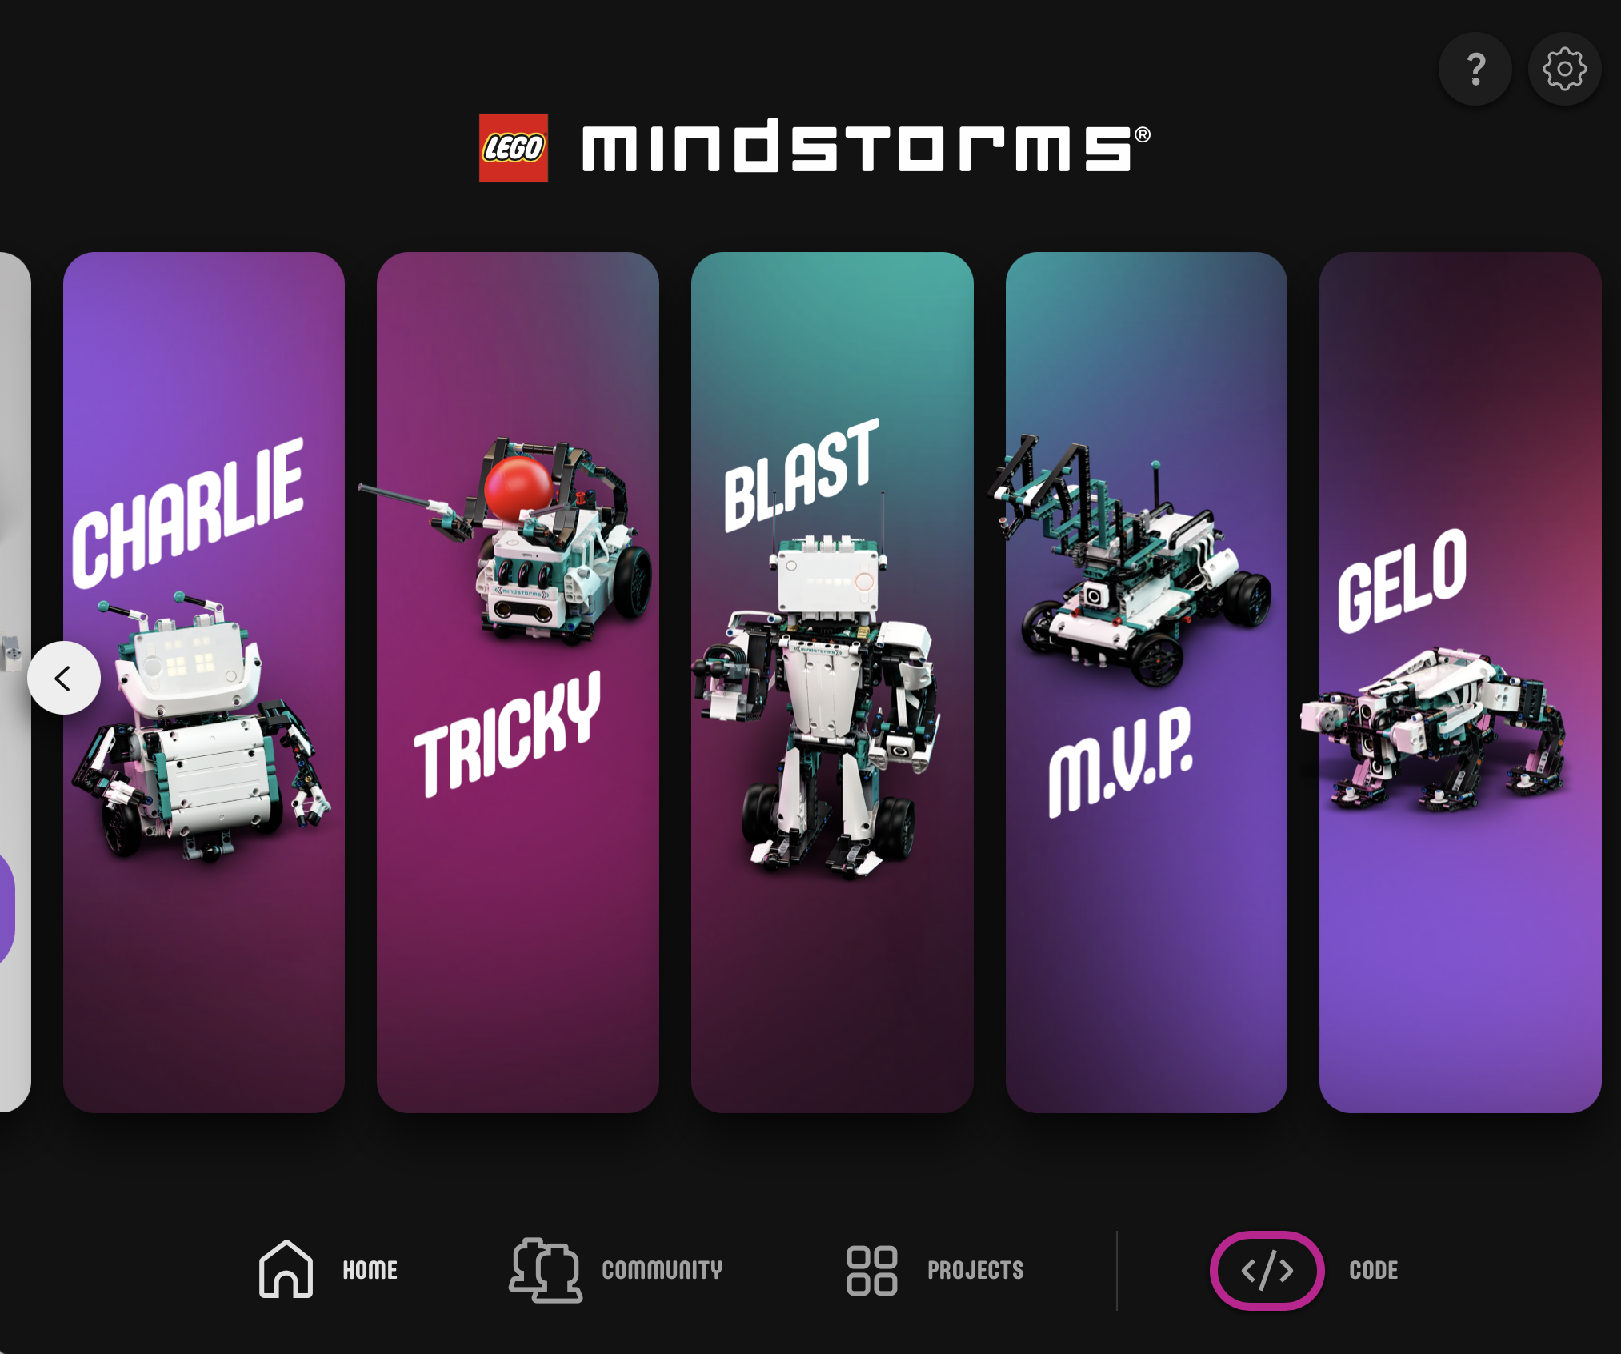
HOME MENU
Build Instructions
Help Menu
6 Tutorials
New and Recent Projects
Help Menu
Free Coding Area
Open Saved Project
Adding Units
Bonus Models from Community
Build Instructions

Slide 7
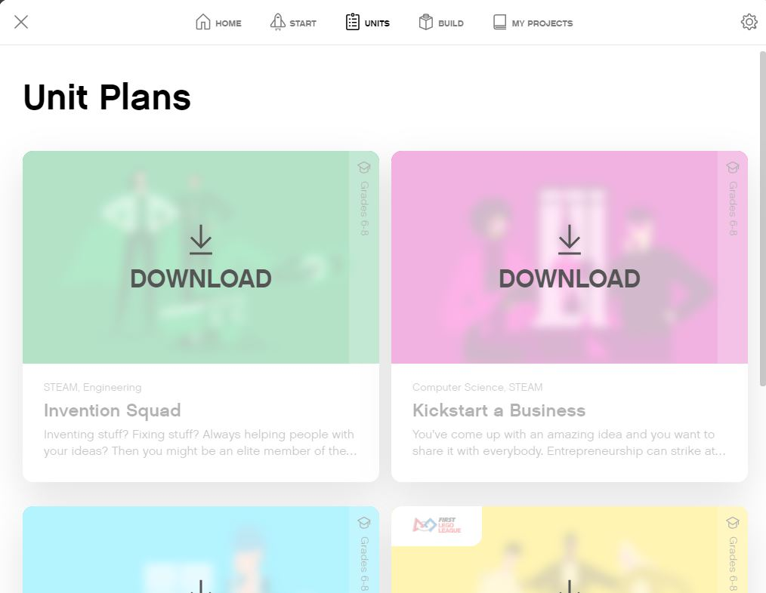
ADDING NEW CONTENT
In SPIKE Prime, you can download new Units
The FIRST LEGO League Curriculum is called “Competition Ready’
In Robot Inventor, you download new Further Activities for the main models or click on the Community Tab from the main screen

Slide 8
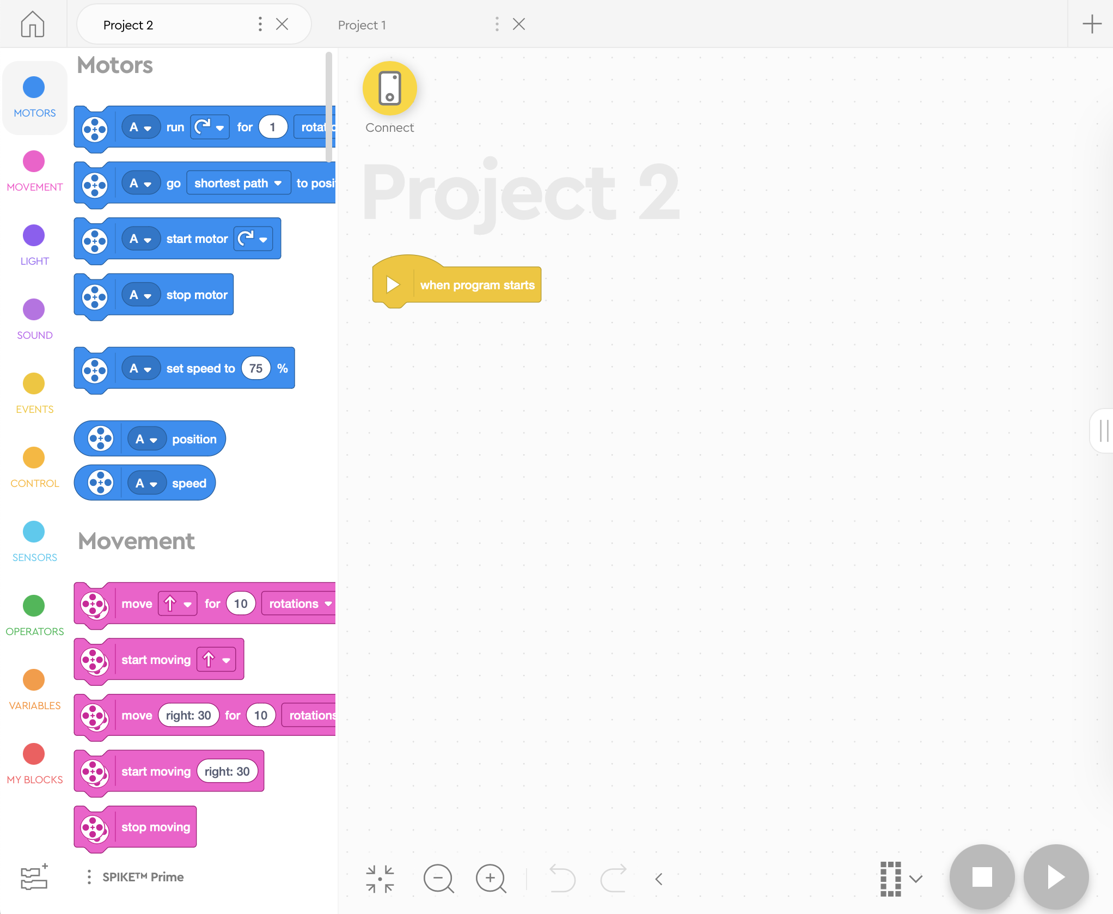
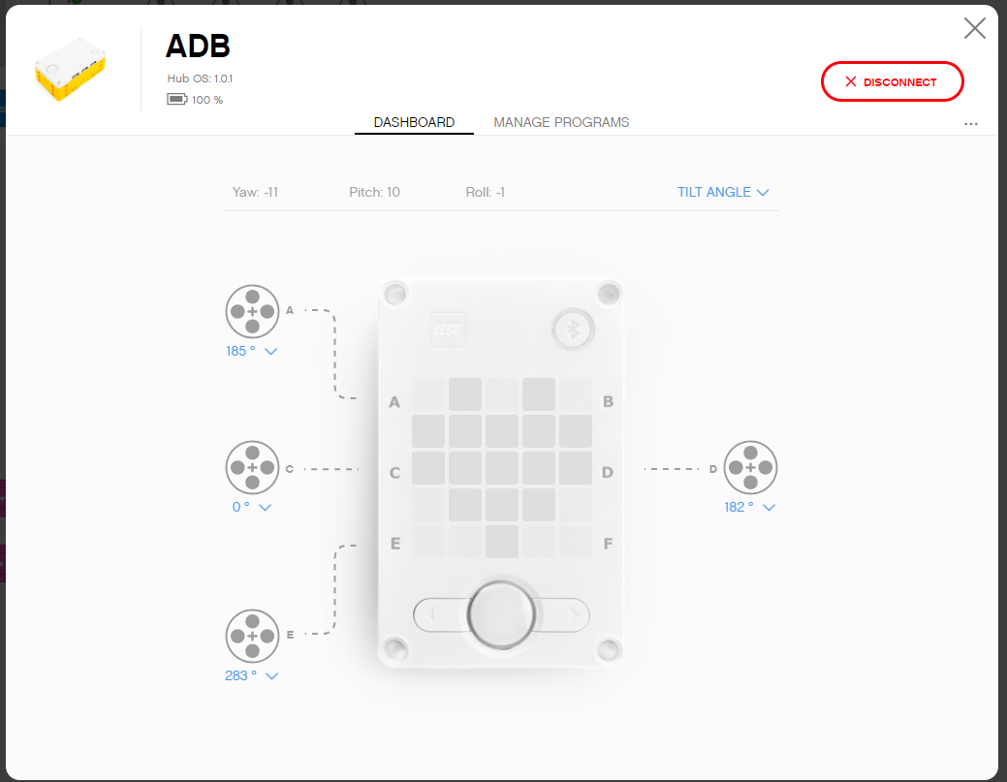
SPIKE PRIME: Programming Canvas Essentials
Back to Home
Opened Project
New Project
Project Properties Rename Project or Move File to new location (i.e. Save as)
Connect to Hub and Access Hub Dashboard
Programming Canvas
Extensions

Slide 9
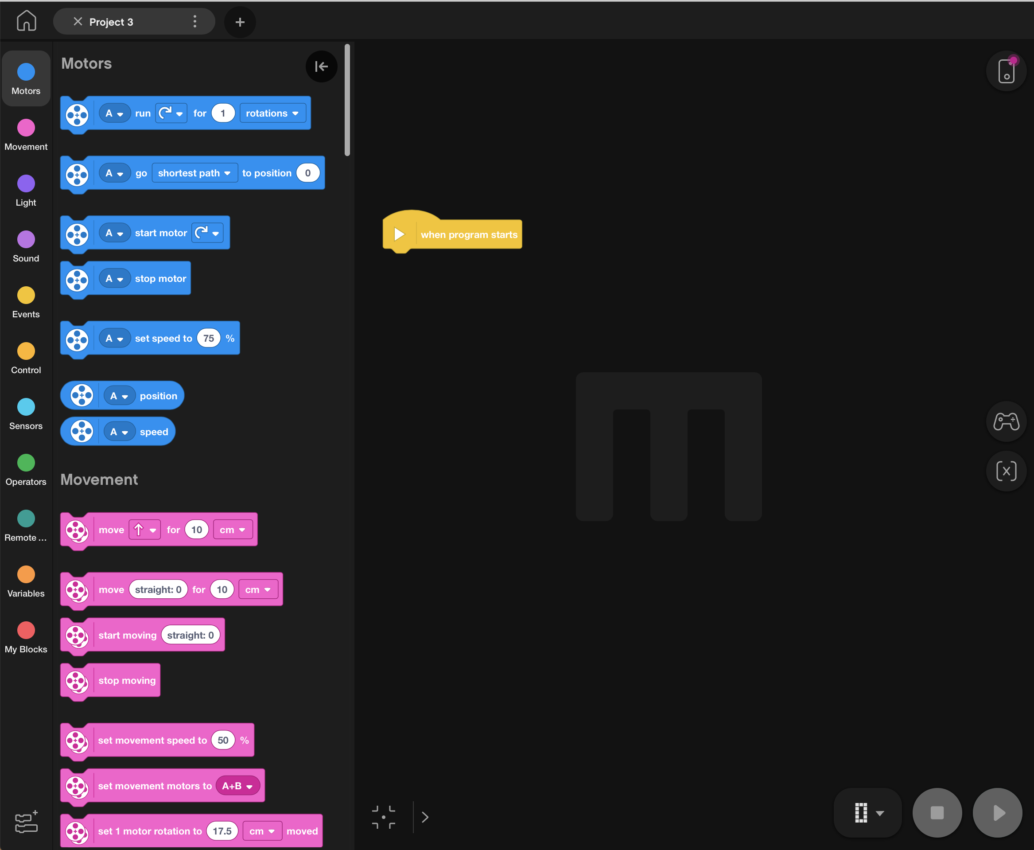
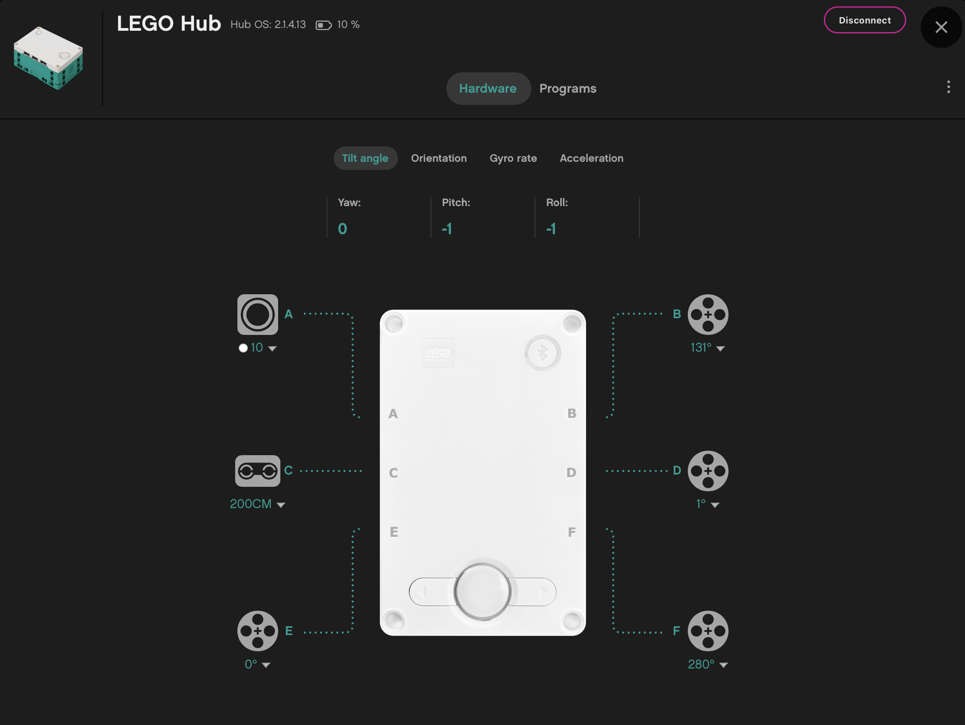
ROBOT INVENTOR: Programming Canvas Essentials
Opened Project
Connect to Hub
Access Hub Dashboard
Project Properties Rename Project or Save As
Programming Canvas
Download Programs
Extensions

Slide 10
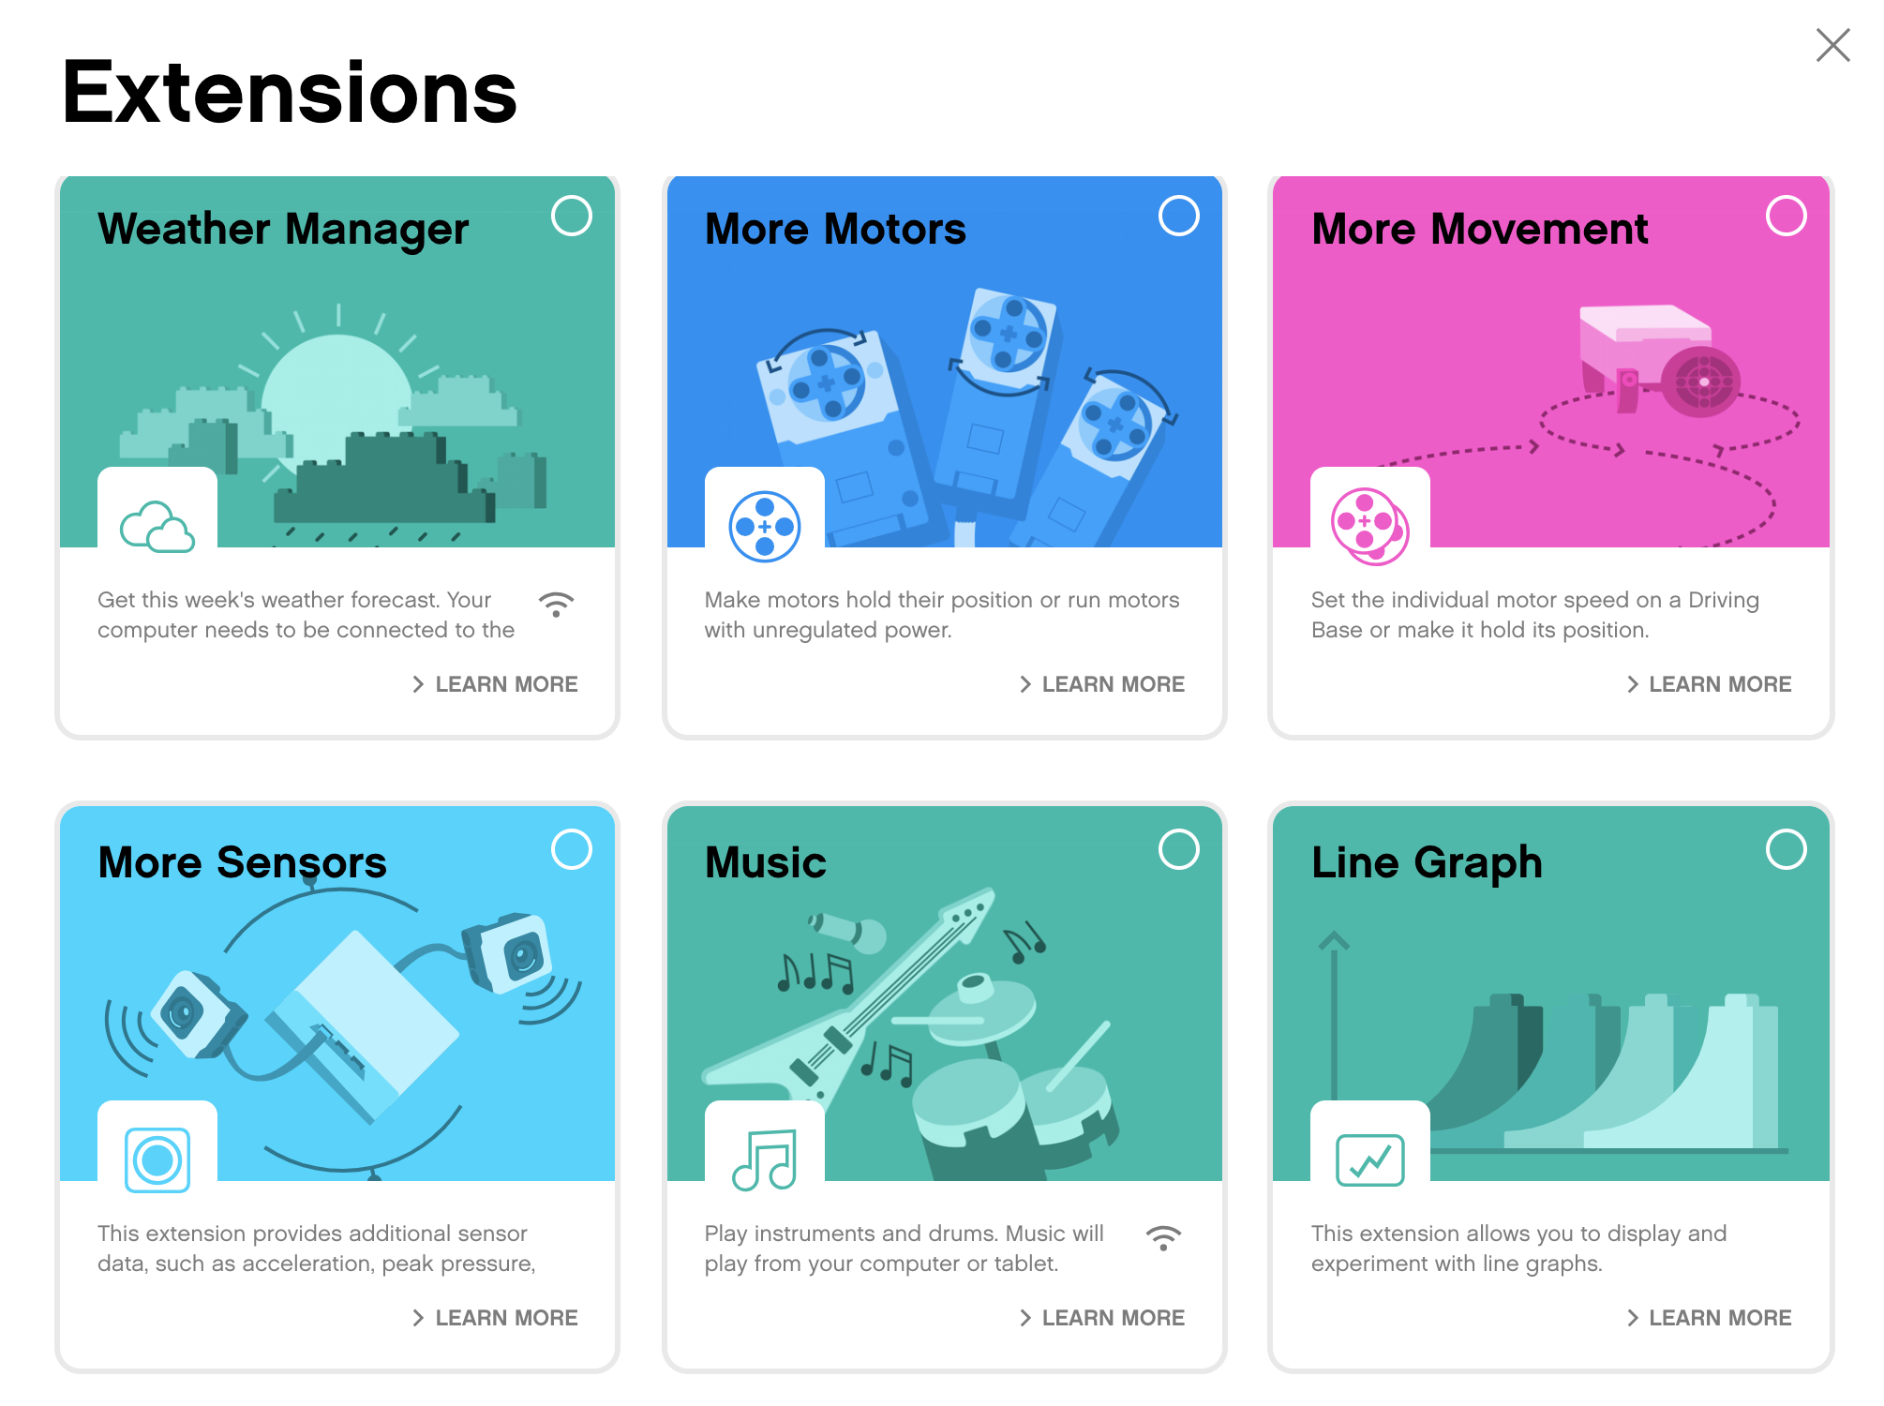
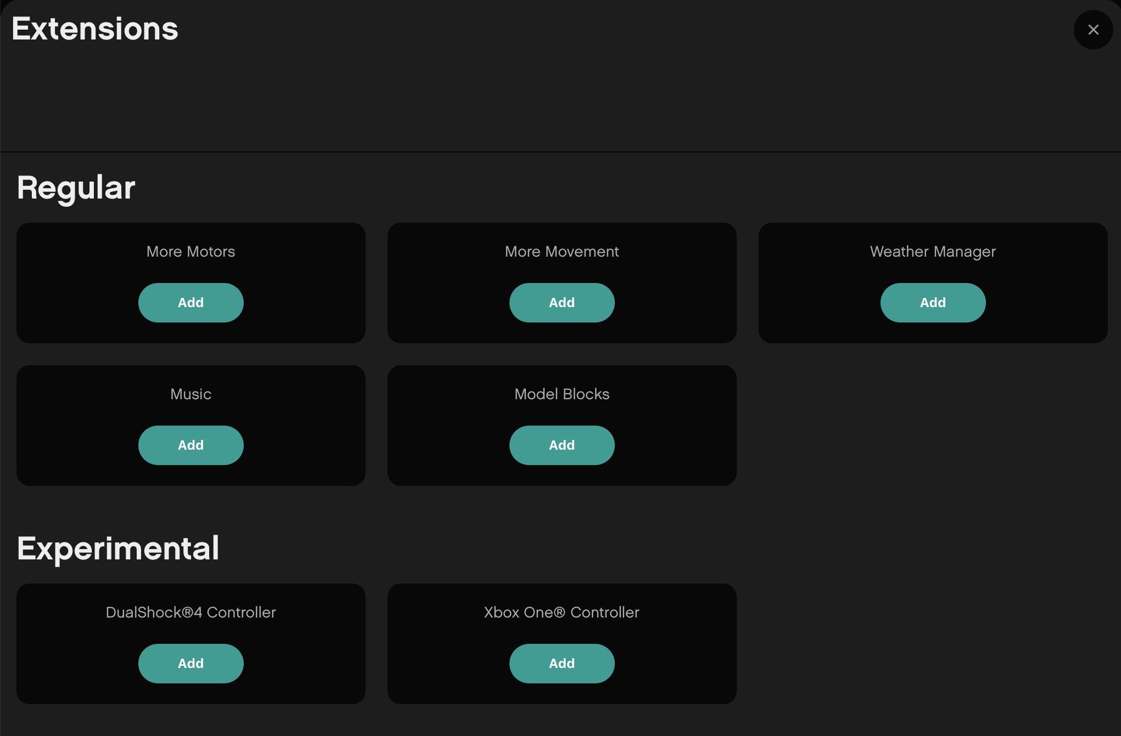
EXTENSIONS: ADDING MORE BLOCKS
When you open either software, not all available blocks are enabled.
Click on the Extensions icon at the bottom of the Block Palette panel
In our lessons, we will use “More Motors” and “More Movement” often
These blocks will show up as separate tabs in the programming palette once downloaded.

Slide 11
Programming Canvas
Block Palette
The main programming canvas is where you will create each program (called ‘Project’)
All the programming blocks are on the Block pallet on the left
The Connect Icon lets you access the Hub Dashboard
The Download Icon lets you pick the mode to download
Hub Dashboard
Download
Download
Stop and Play

Slide 12
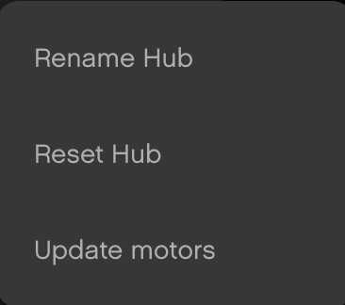
HUB DASHBOARD
You must connect your Hub to access this section (click on the small Hub icon)
This section is very useful for:
Checking battery level
Hub OS version
Gyro Sensor Values
See which motors and sensors are connected
Get real time values from the motors and sensors
Clicking three dots (…) lets you rename and reset your but and calibrate your motors
The Manage Programs has a list of all programs on the Hub (maximum of 20). Use this section to change the order of the programs.

Slide 13
BLOCK PALETTE OVERVIEW FOR SPIKE PRIME & ROBOT INVENTOR
Motors – Control an individual motor
Movement – Control two motors at a time with synchronization
Light – Program the 5X5 matrix
Sound – Play a sound
Events – Run actions based on events (e.g. sensor or timer)
Control – Loops, if/else statements, etc.
Sensors – Read a sensor value
Operators – Mathematics and logic
Variables – Store data in a variable or list
My Blocks – Custom defined blocks
More Movement – Additional movement blocks
More Motors – Additional motor blocks
Weather – Access weather information and forecasts
Music – Play musical notes and select instrument
More Sensors – Raw color values, acceleration
Music – Pick instruments and tempo
Line Graph - Datalogging
Display – Display images
Motors – Control an individual motor
Movement – Control two motors at a time with synchronization
Light – Program the 5X5 matrix
Sound – Play a sound
Events – Run actions based on events (e.g. sensor or timer)
Control – Loops, if/else statements, etc.
Sensors – Read a sensor value
Operators – Mathematics and logic
Variables – Store data in a variable or list
My Blocks – Custom defined blocks
More Movement – Additional movement blocks
More Motors – Additional motor blocks
Weather Manager – Access weather information and forecasts
Music – Play musical notes and select instrument
Model Blocks – Coding Blocks for 5 built-in models
DualShock 4 Controller
Xbox One Controller
SPIKE PRIME
ROBOT INVENTOR

Slide 14
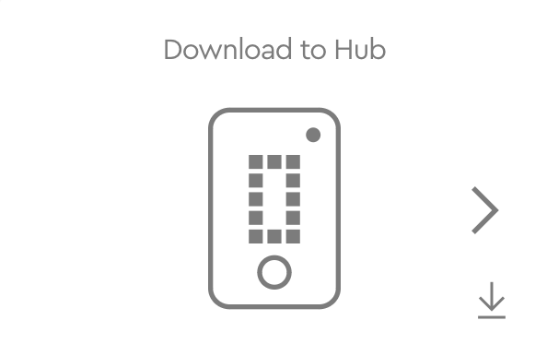
DownloadING CODE to YOUR HUB
Download: The program runs on the hub and can be run at any time with or without your PC
Use the right arrow to select which slot you want to download your program to (0-19).
Once the code is on your hub, you can use the arrow keys on your hub to pick the correct program number.
Note: FIRST LEGO League Teams must Download code to their Hub. At robot matches, they will play their code using the Hub. There is no current method to recover code from the Hub if you lose your saved file on your computer. Save often and keep backups of the code.

Slide 15
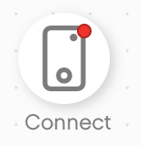
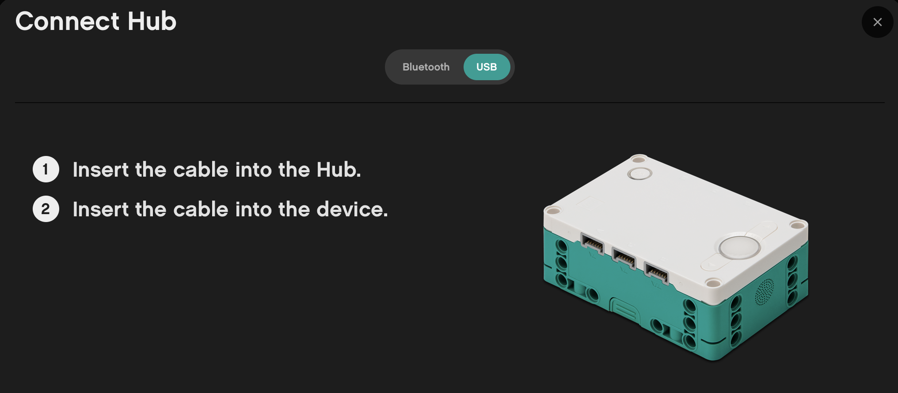
Connecting to HUB
For both SPIKE Prime and Robot Inventor, the software will auto-connect to the Hub if you are using a USB cable
To connect over Bluetooth, click the connect icon in the software. (the small Hub icon)
Enable Bluetooth by pressing the Bluetooth button on the Hub.
Your Hub will show up in the list at the bottom. Select your Hub
Note: FIRST LEGO League Teams will be asked to not use Bluetooth in competition areas. Bring a USB cable to events to modify your code.

Slide 16
CREDITS
This lesson was created by Sanjay Seshan and Arvind Seshan for Prime Lessons
More lessons are available at www.primelessons.org
This work is licensed under a Creative Commons Attribution-NonCommercial-ShareAlike 4.0 International License.

